Slide 1
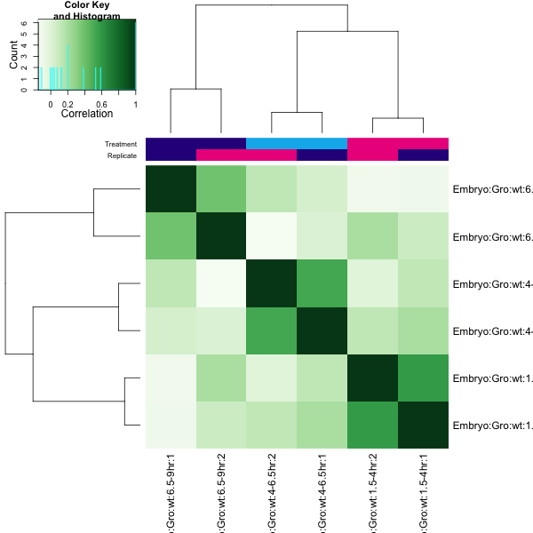
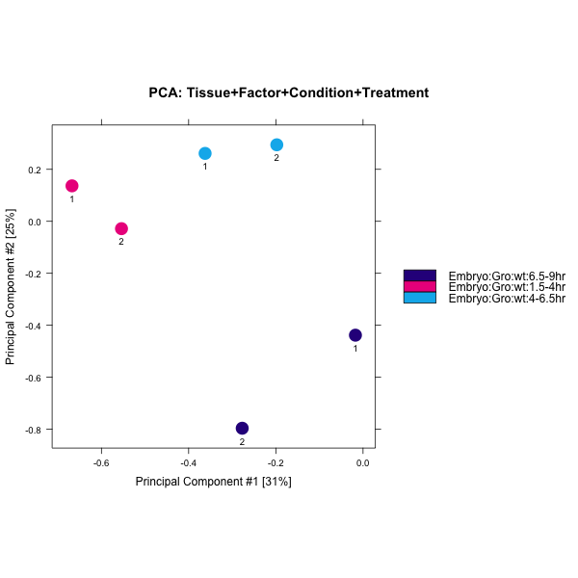
Fig. 2-a
A
B
C

Slide 2
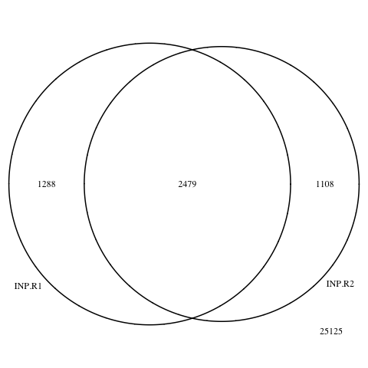
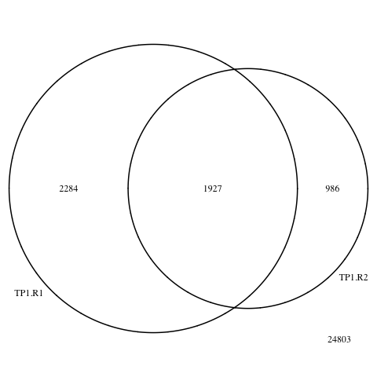
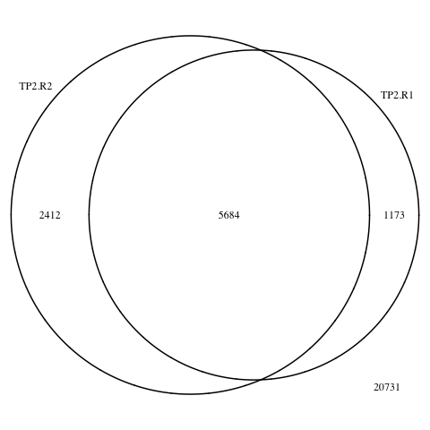
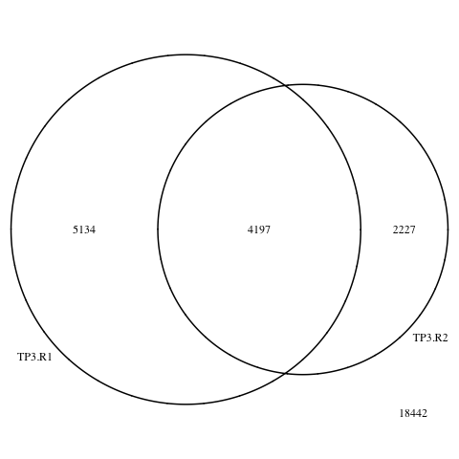
Fig. 2-b
Input
1.5 – 4 hr
4 – 6.5 hr
6.5 – 9 hr

Slide 3
Fig. 2-c
A
B

Slide 4
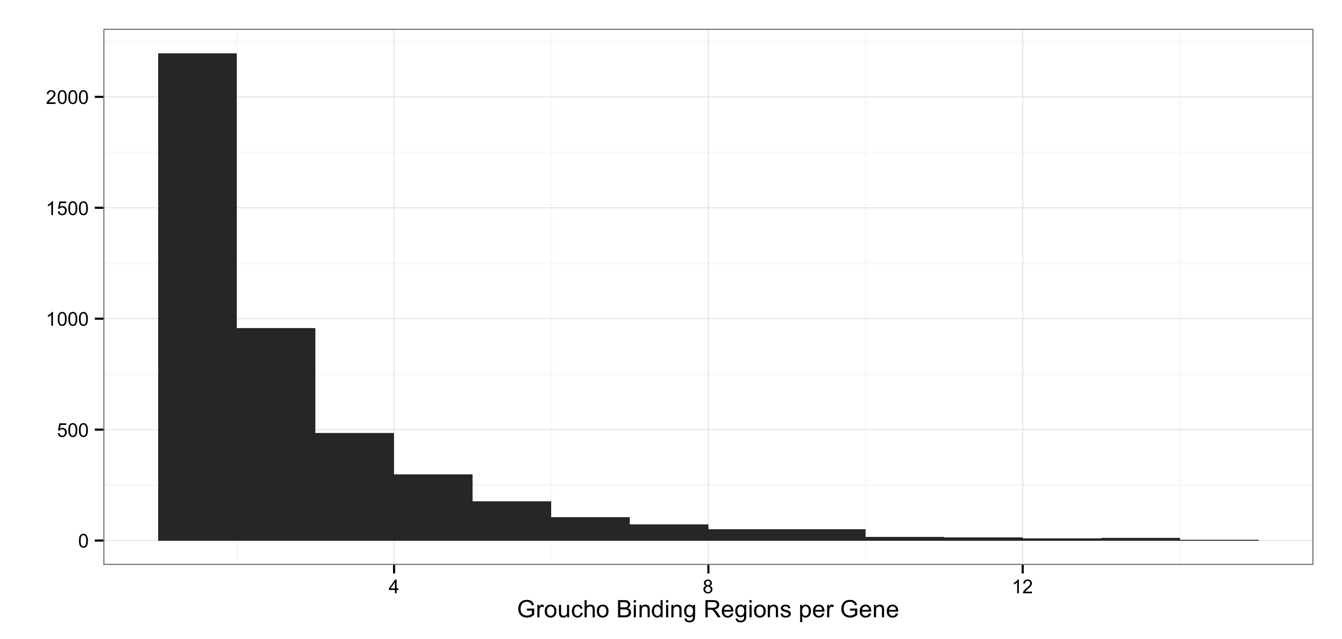
Fig. 2-d
A
B

Slide 5
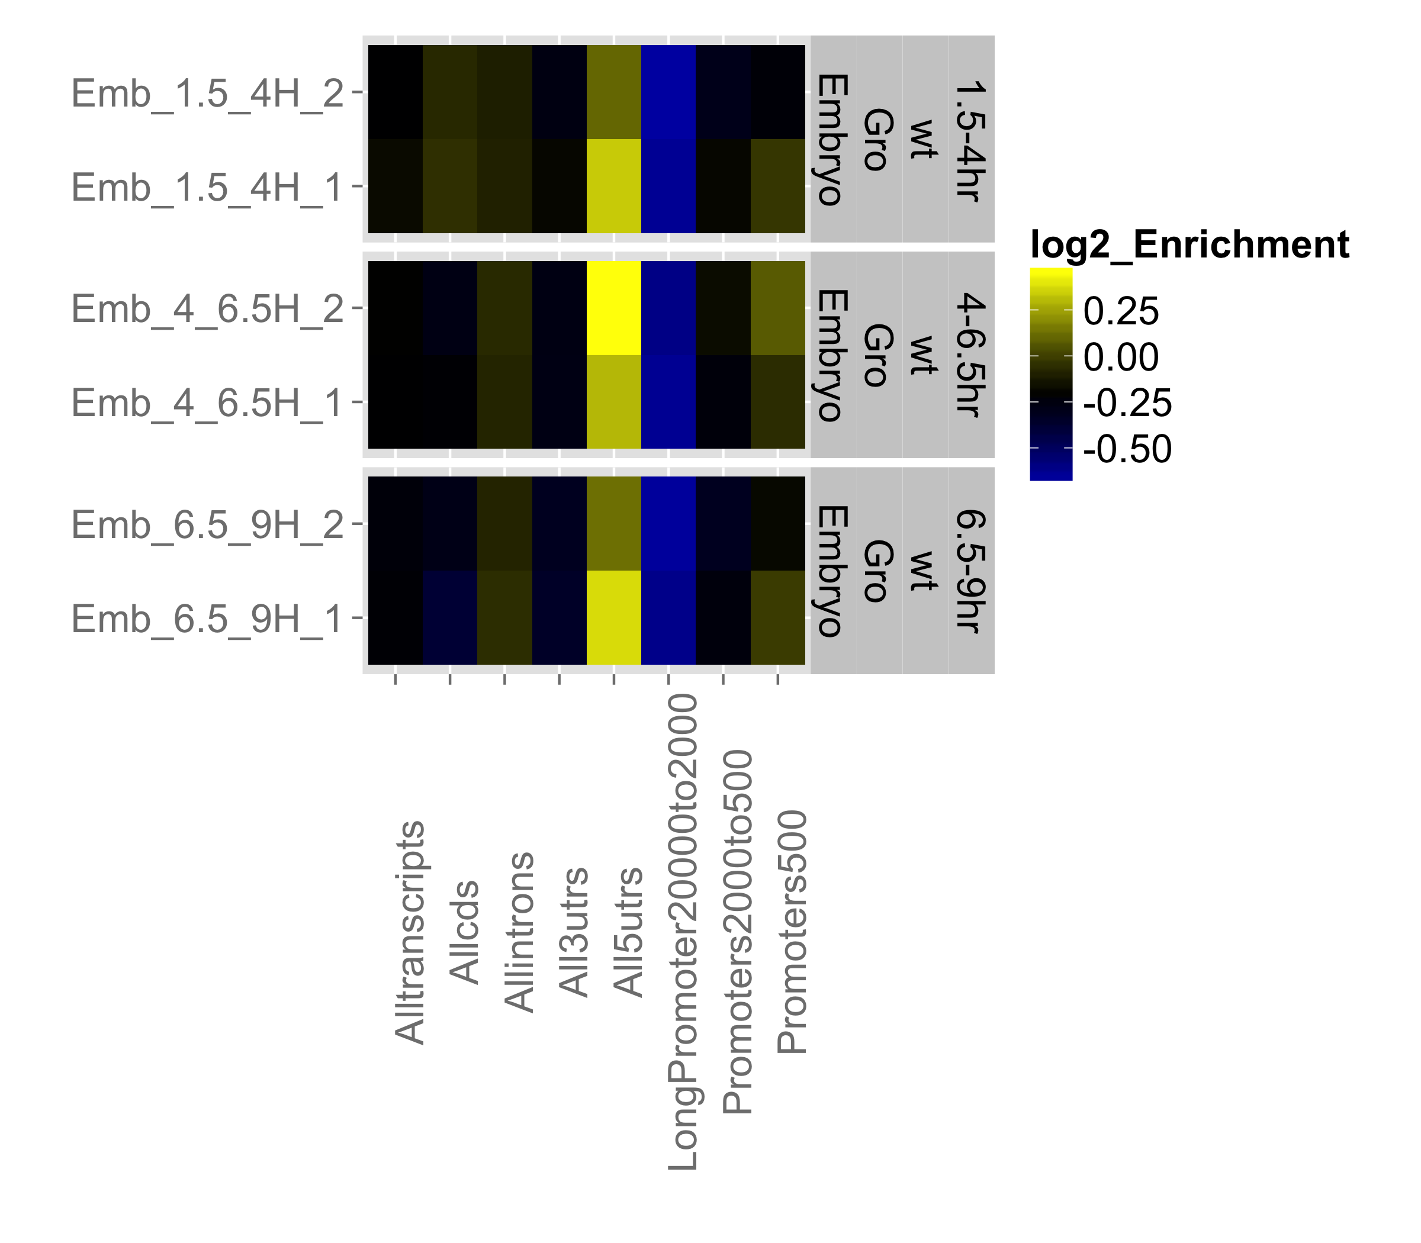
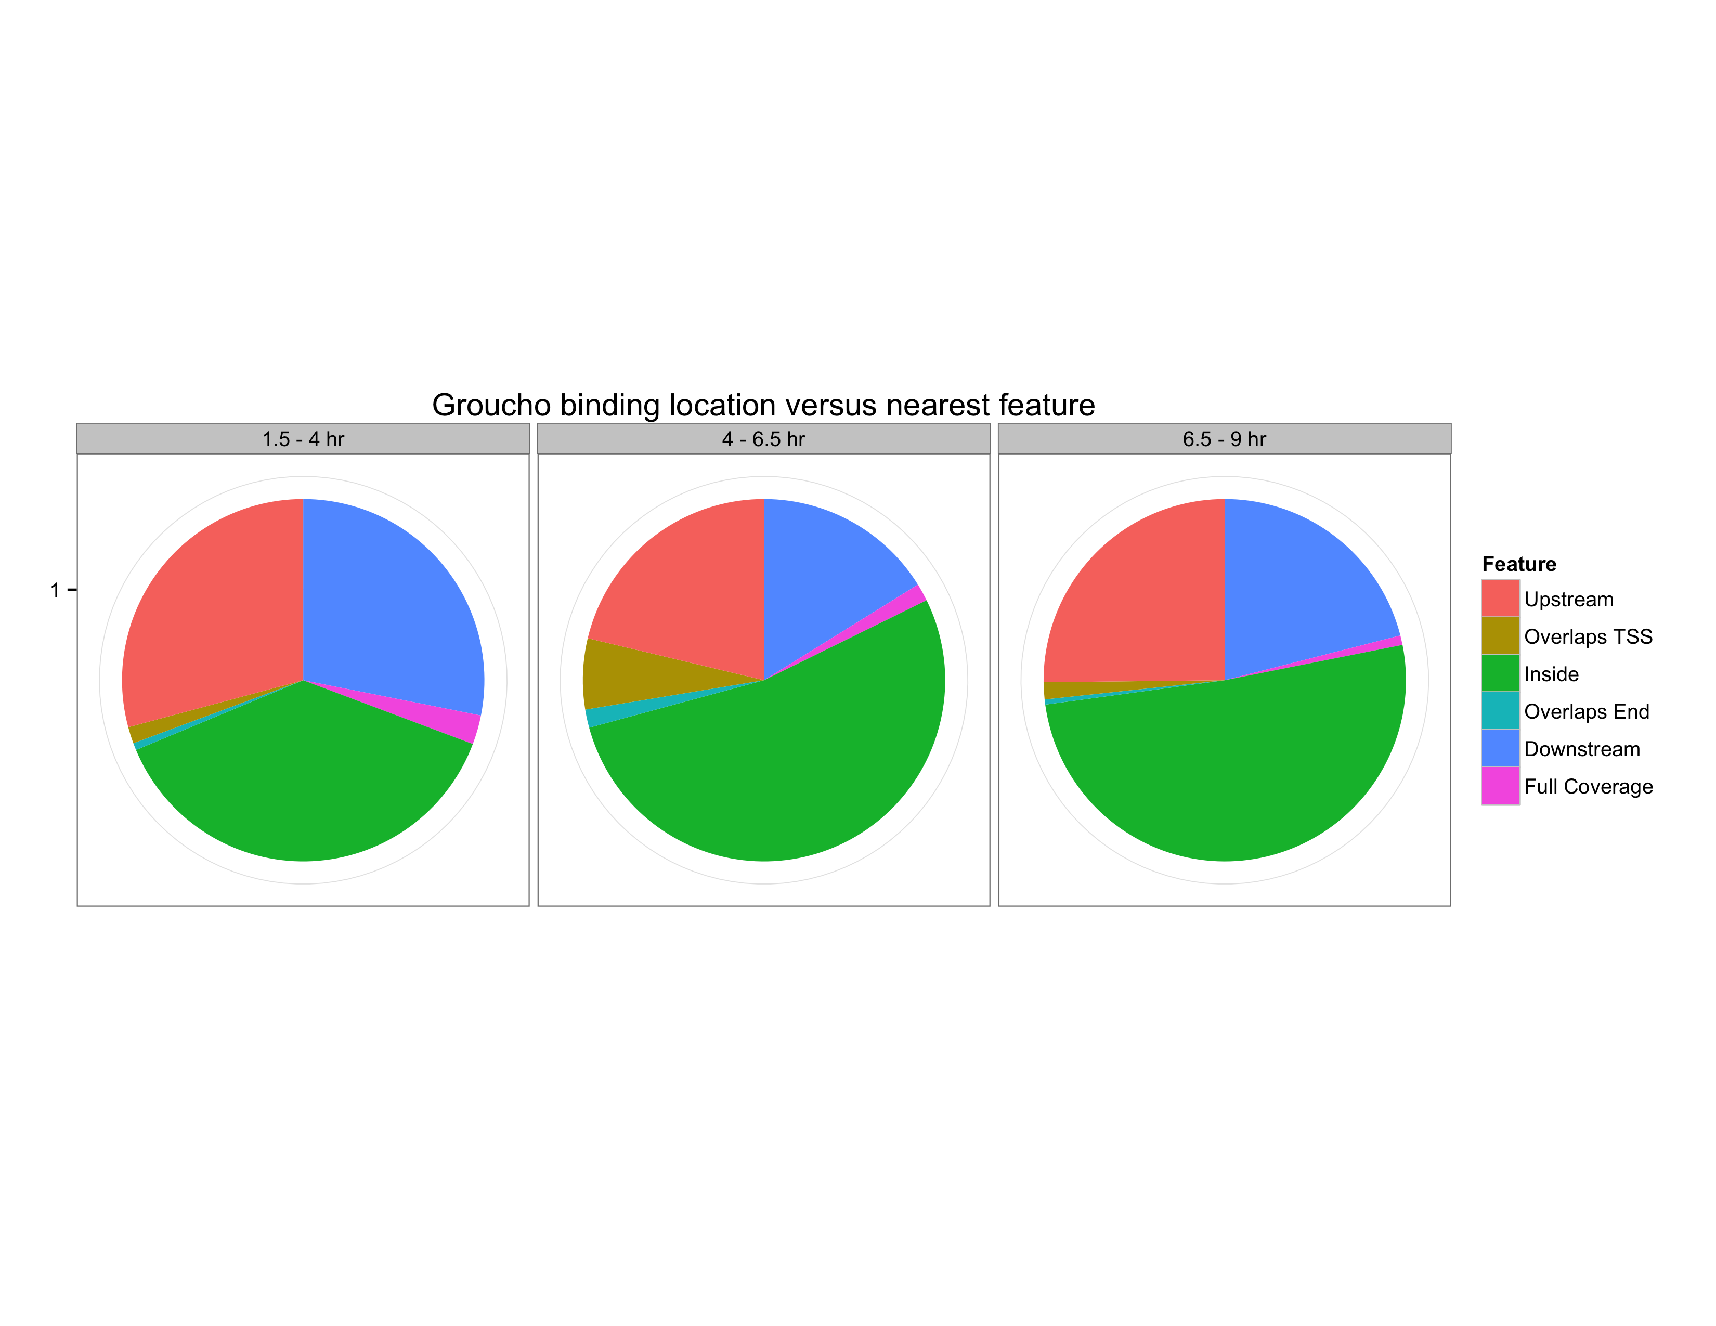
Fig. 2-e
A
B

Slide 6
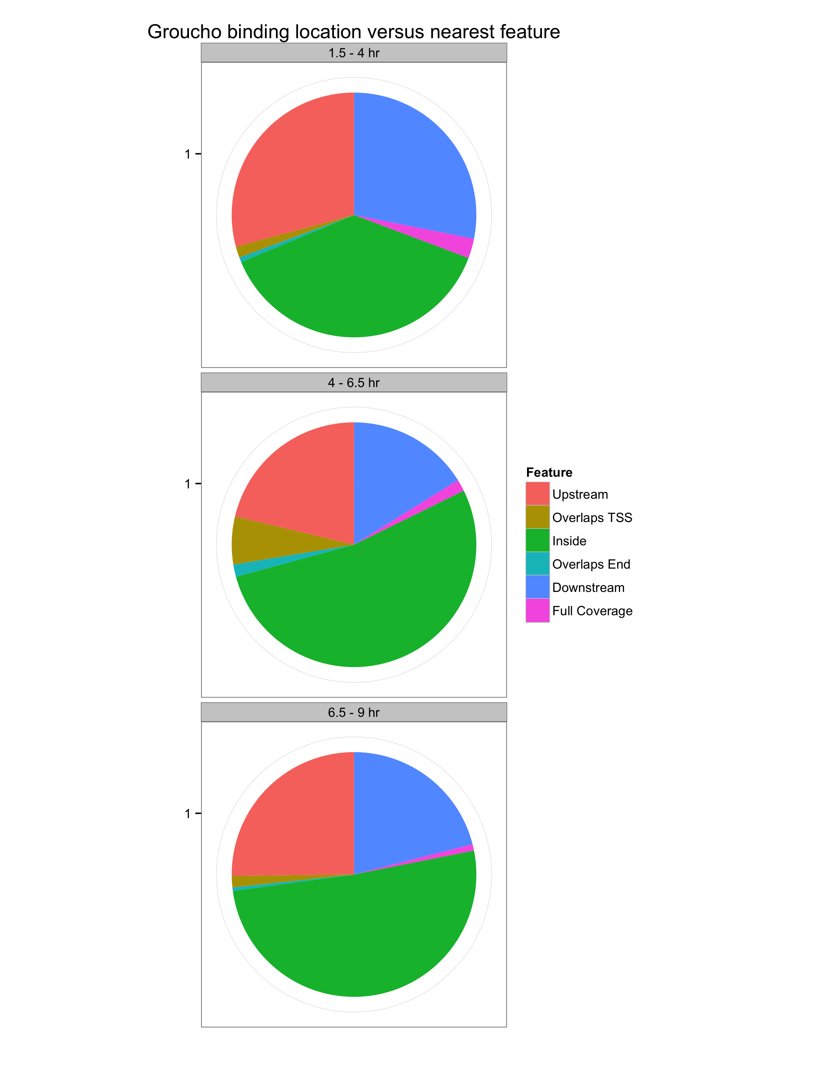
Fig. 2-f

Slide 7
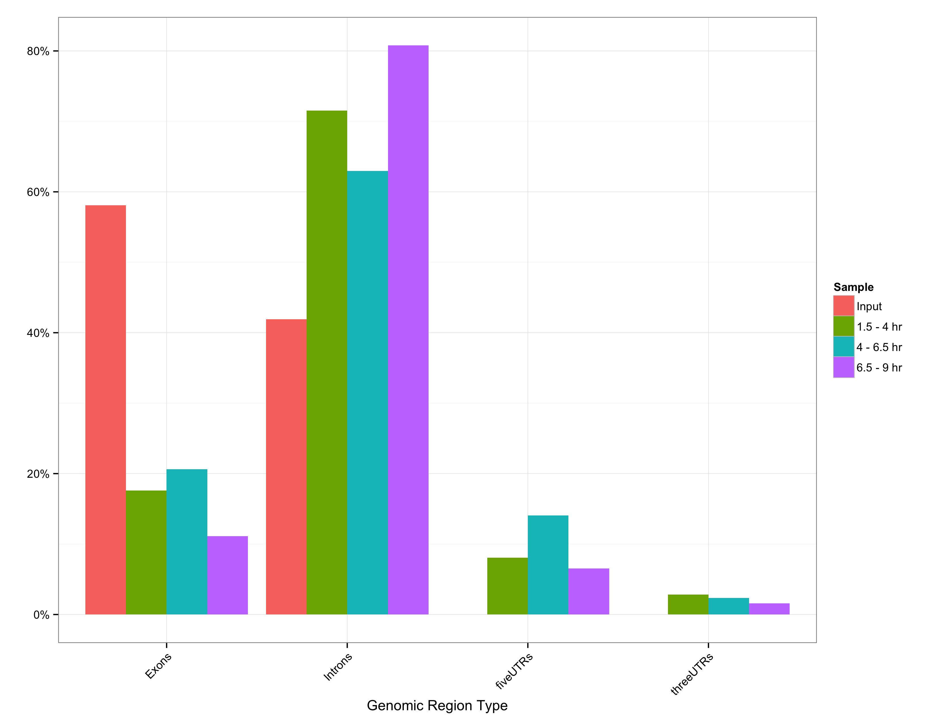
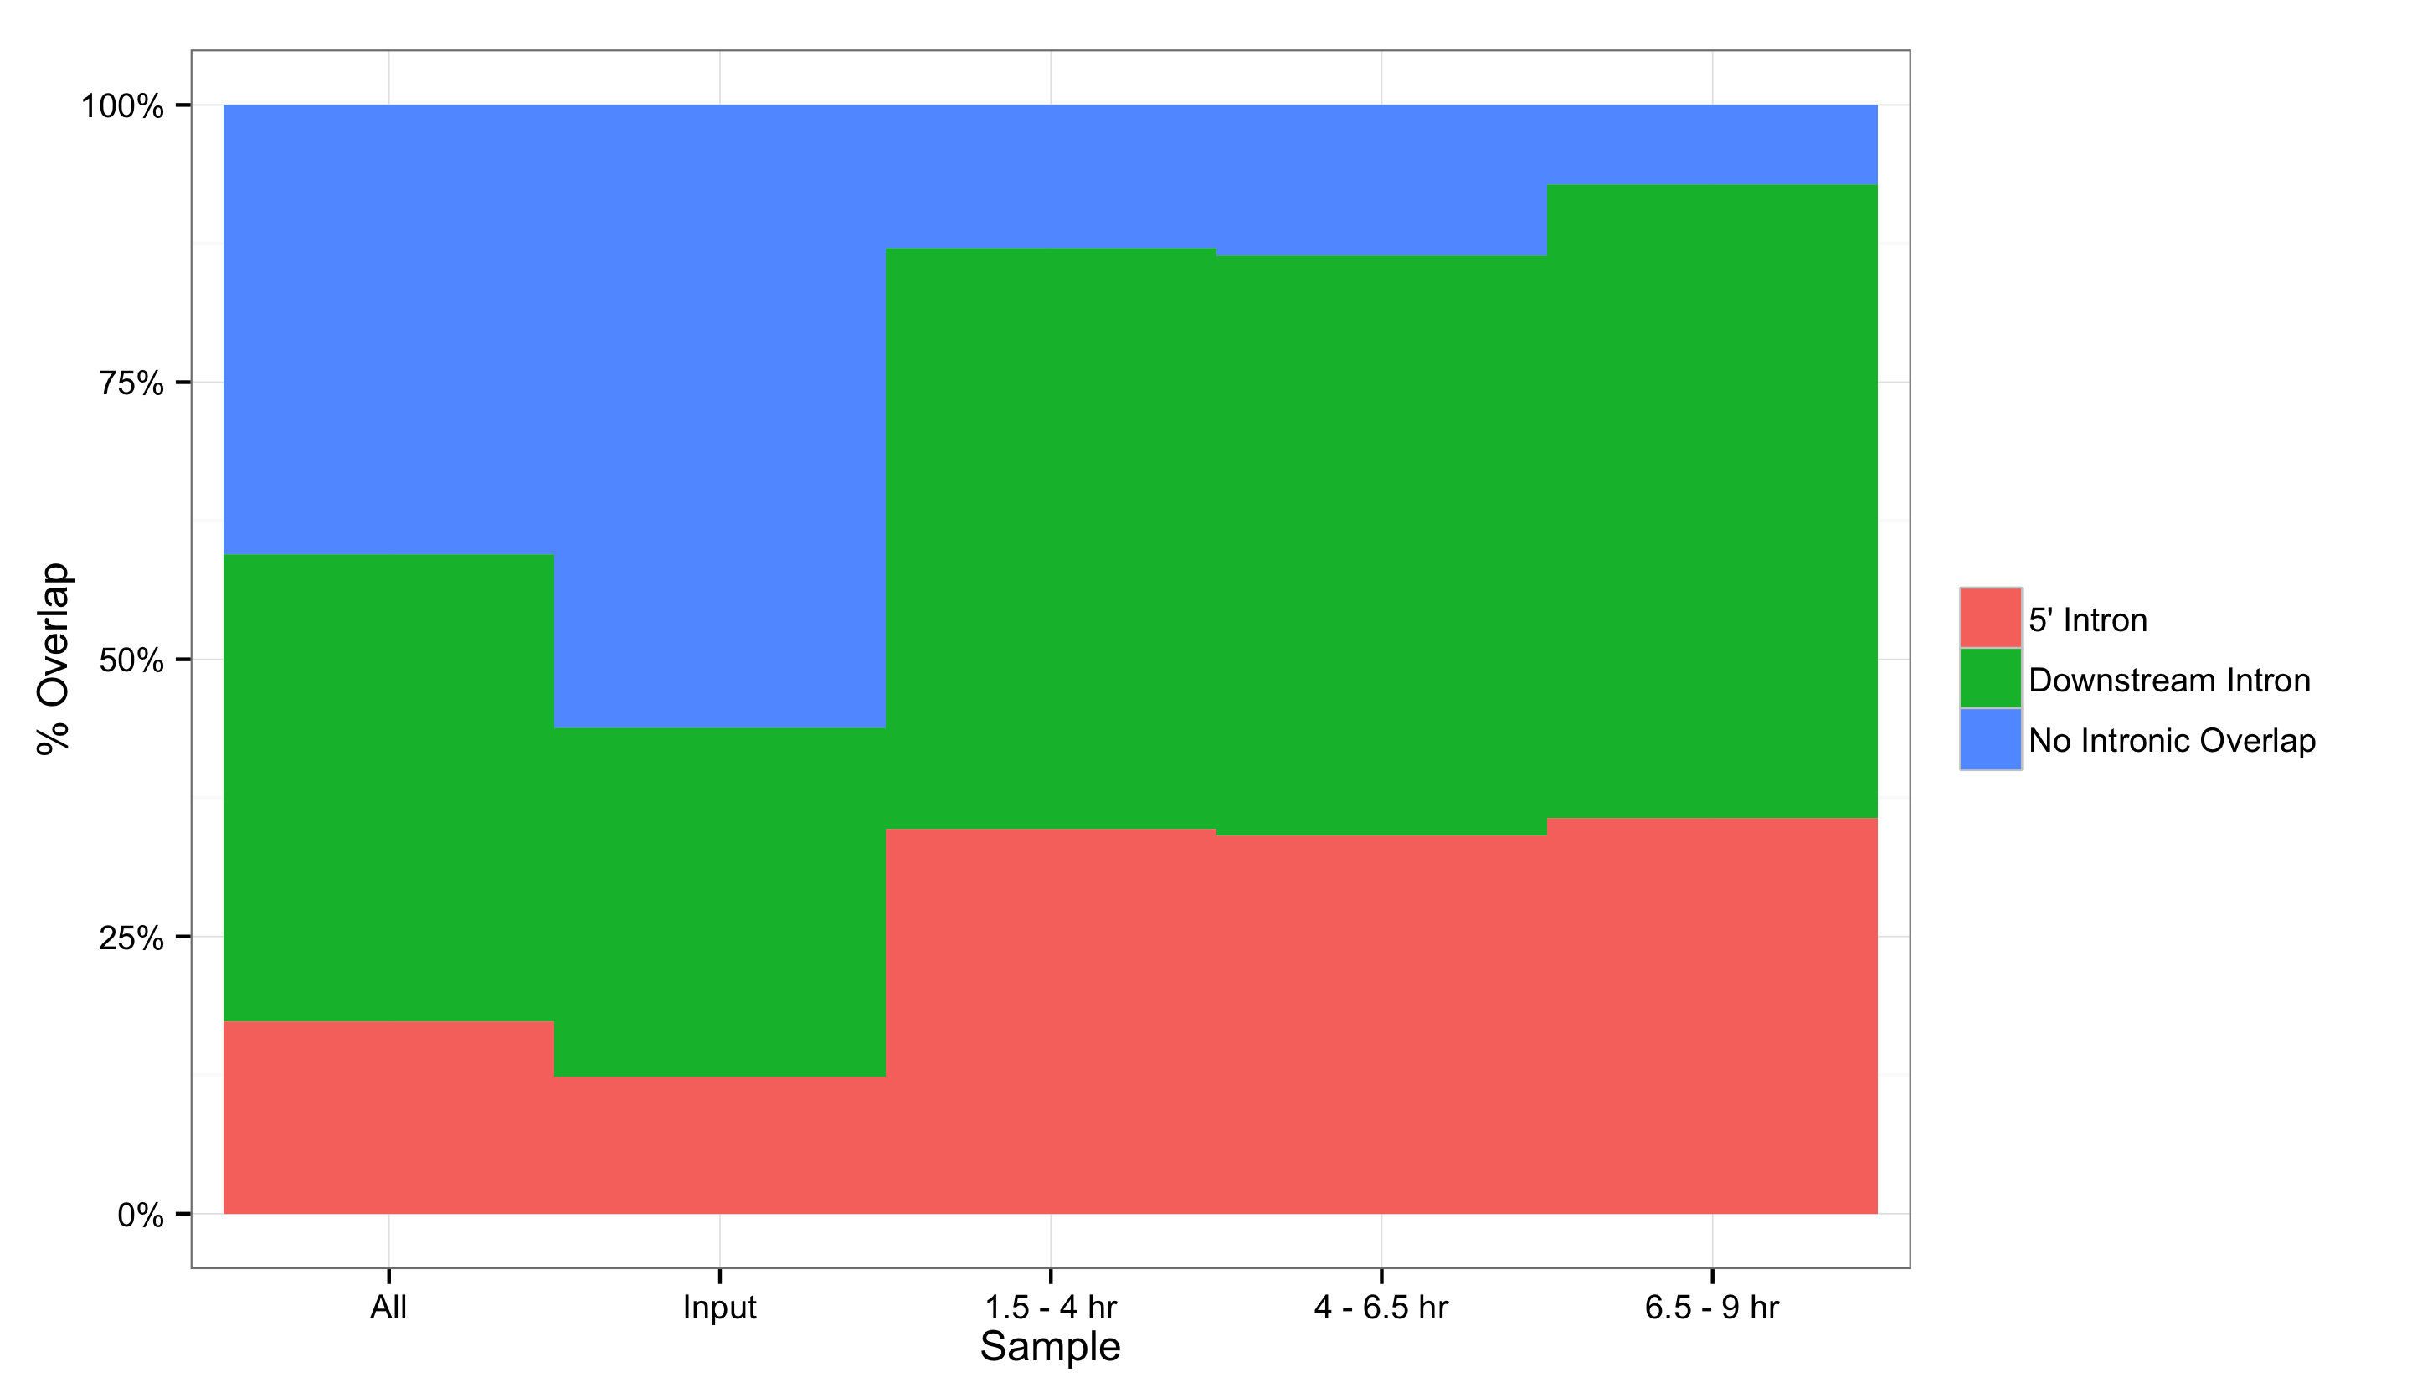
Fig. 2-g
A
B

Slide 8
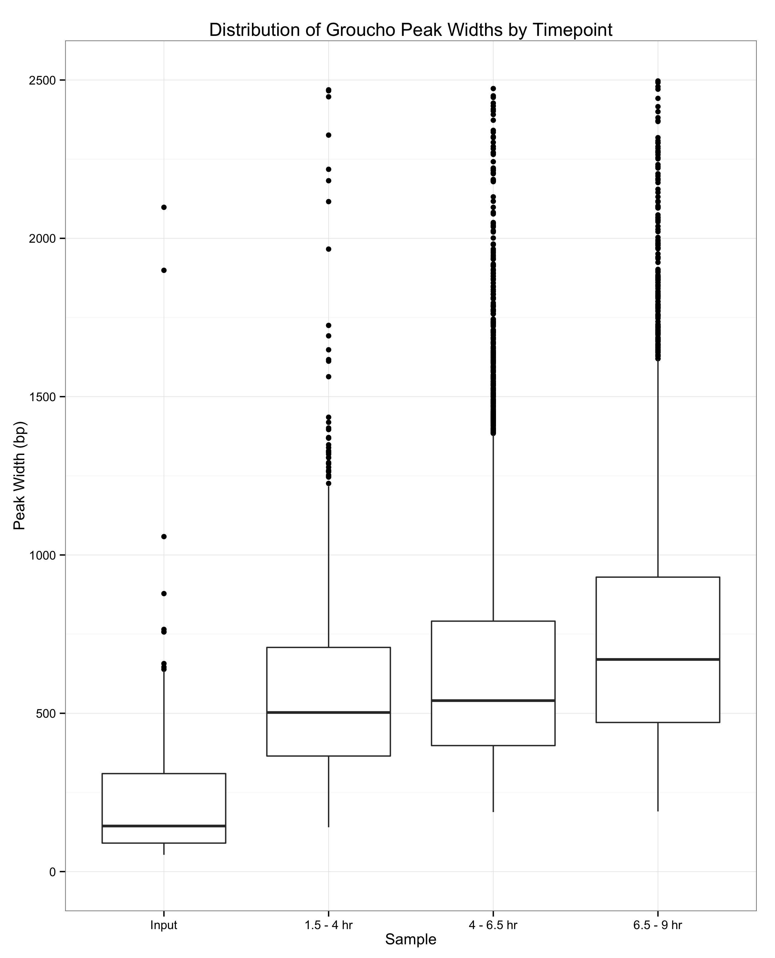
Fig. 2-h

Slide 9
Fig. 2-i

Slide 10
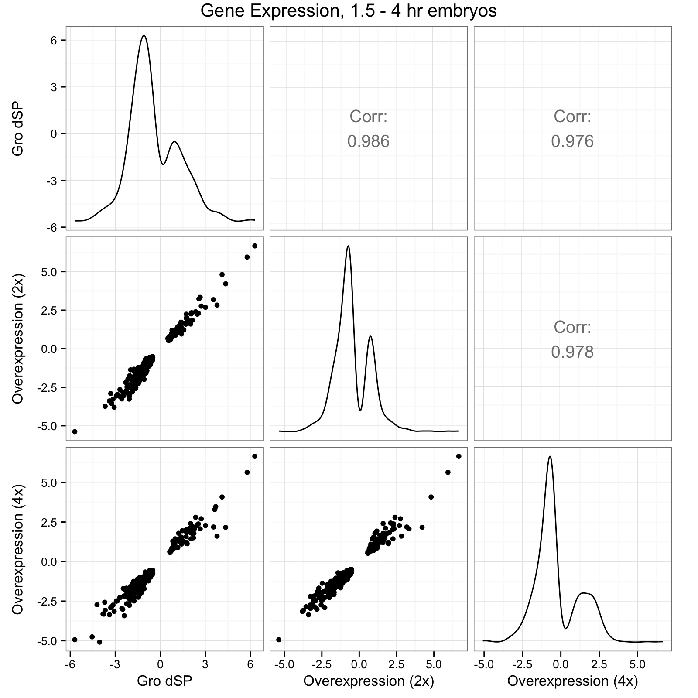
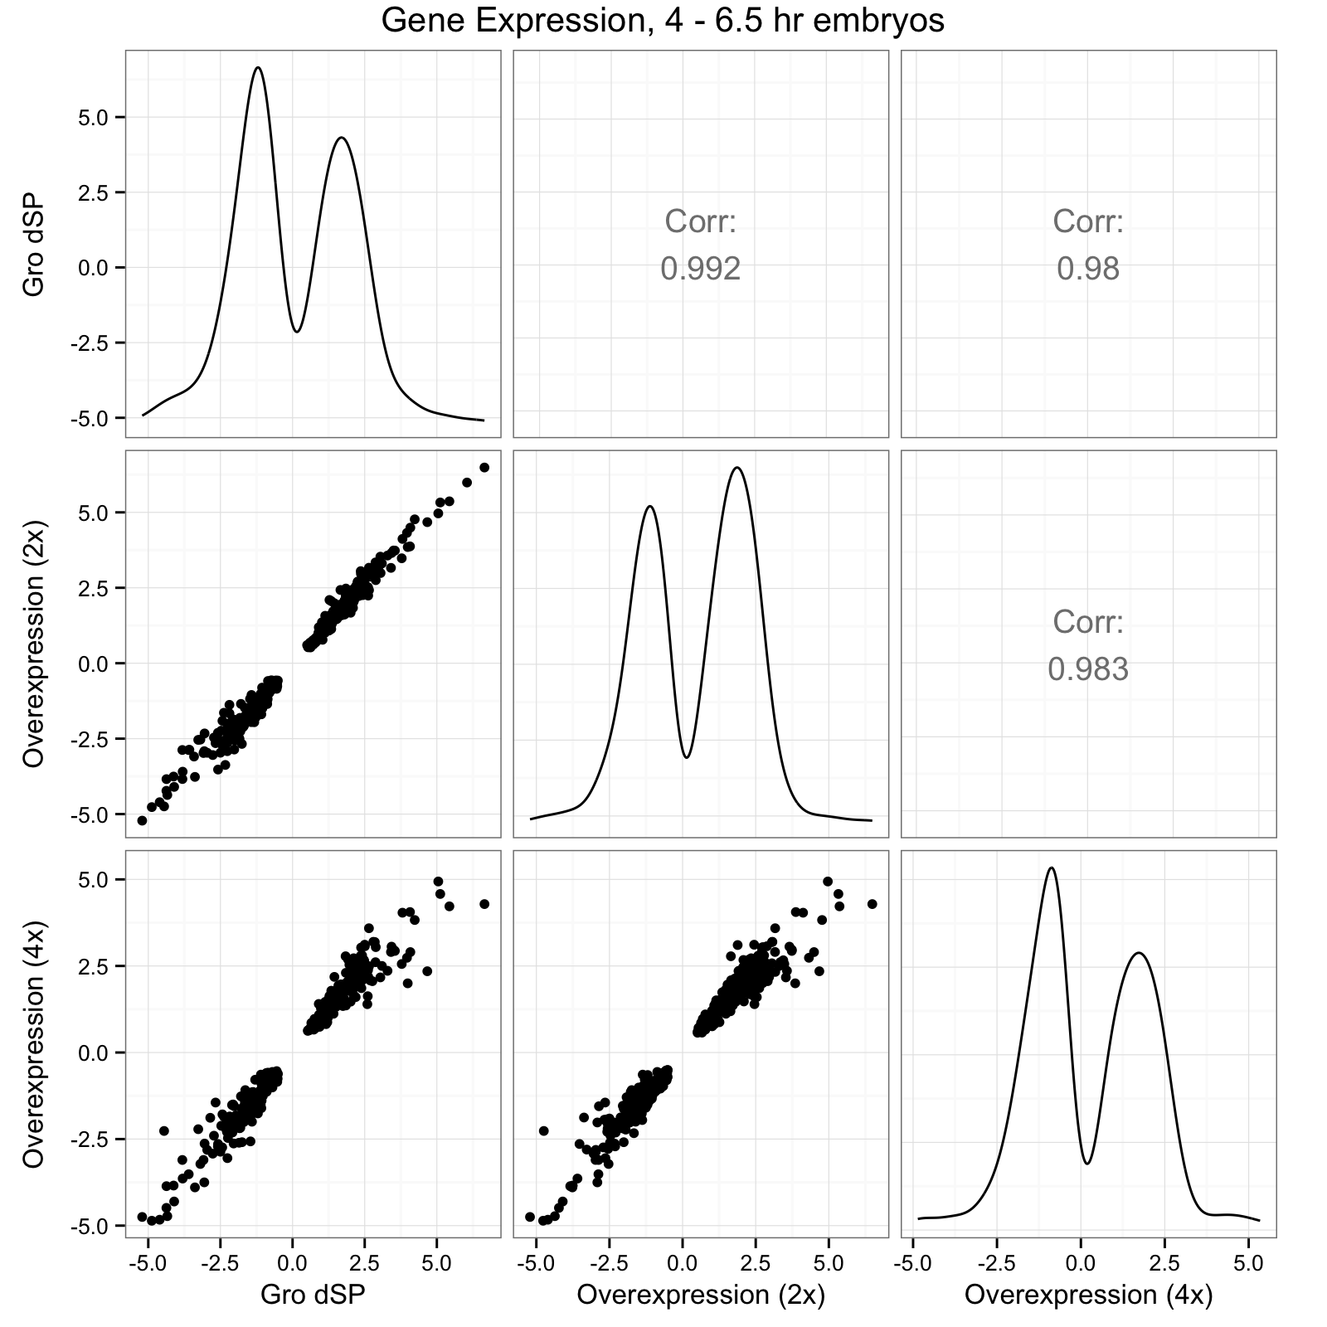
Fig. 2-j

Slide 11
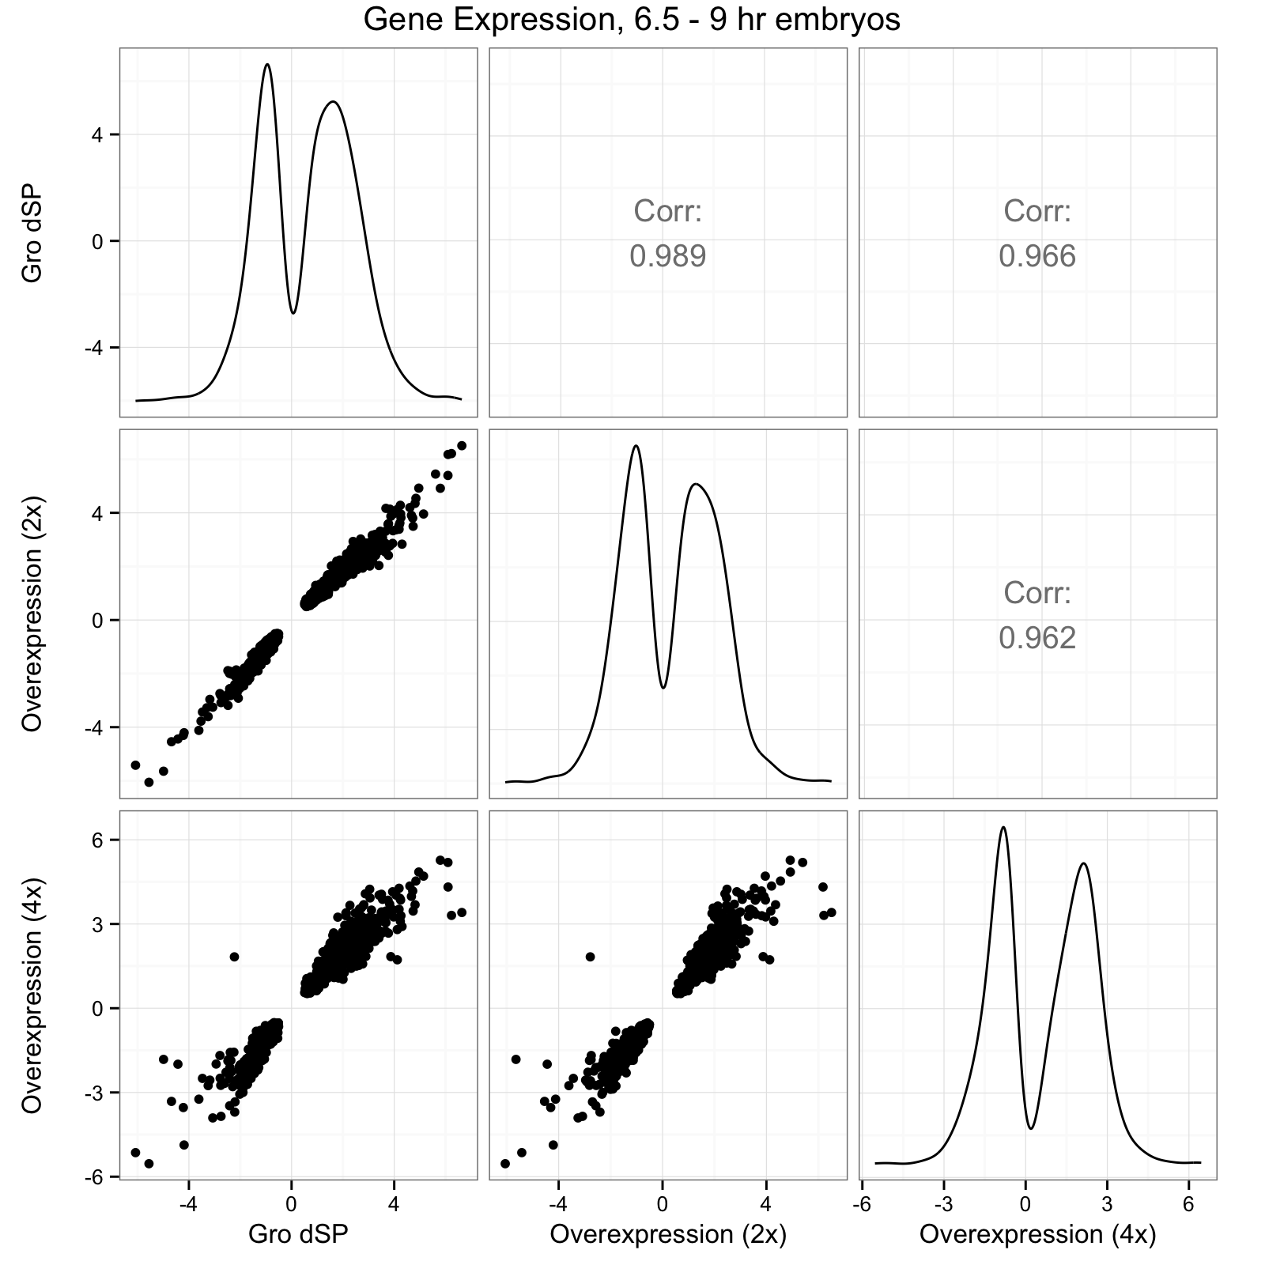
Fig. 2-j (continued)

Slide 12
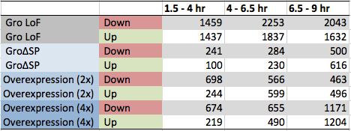
Fig. 2-k
A
B

Slide 13
Fig. 2-l

Slide 14
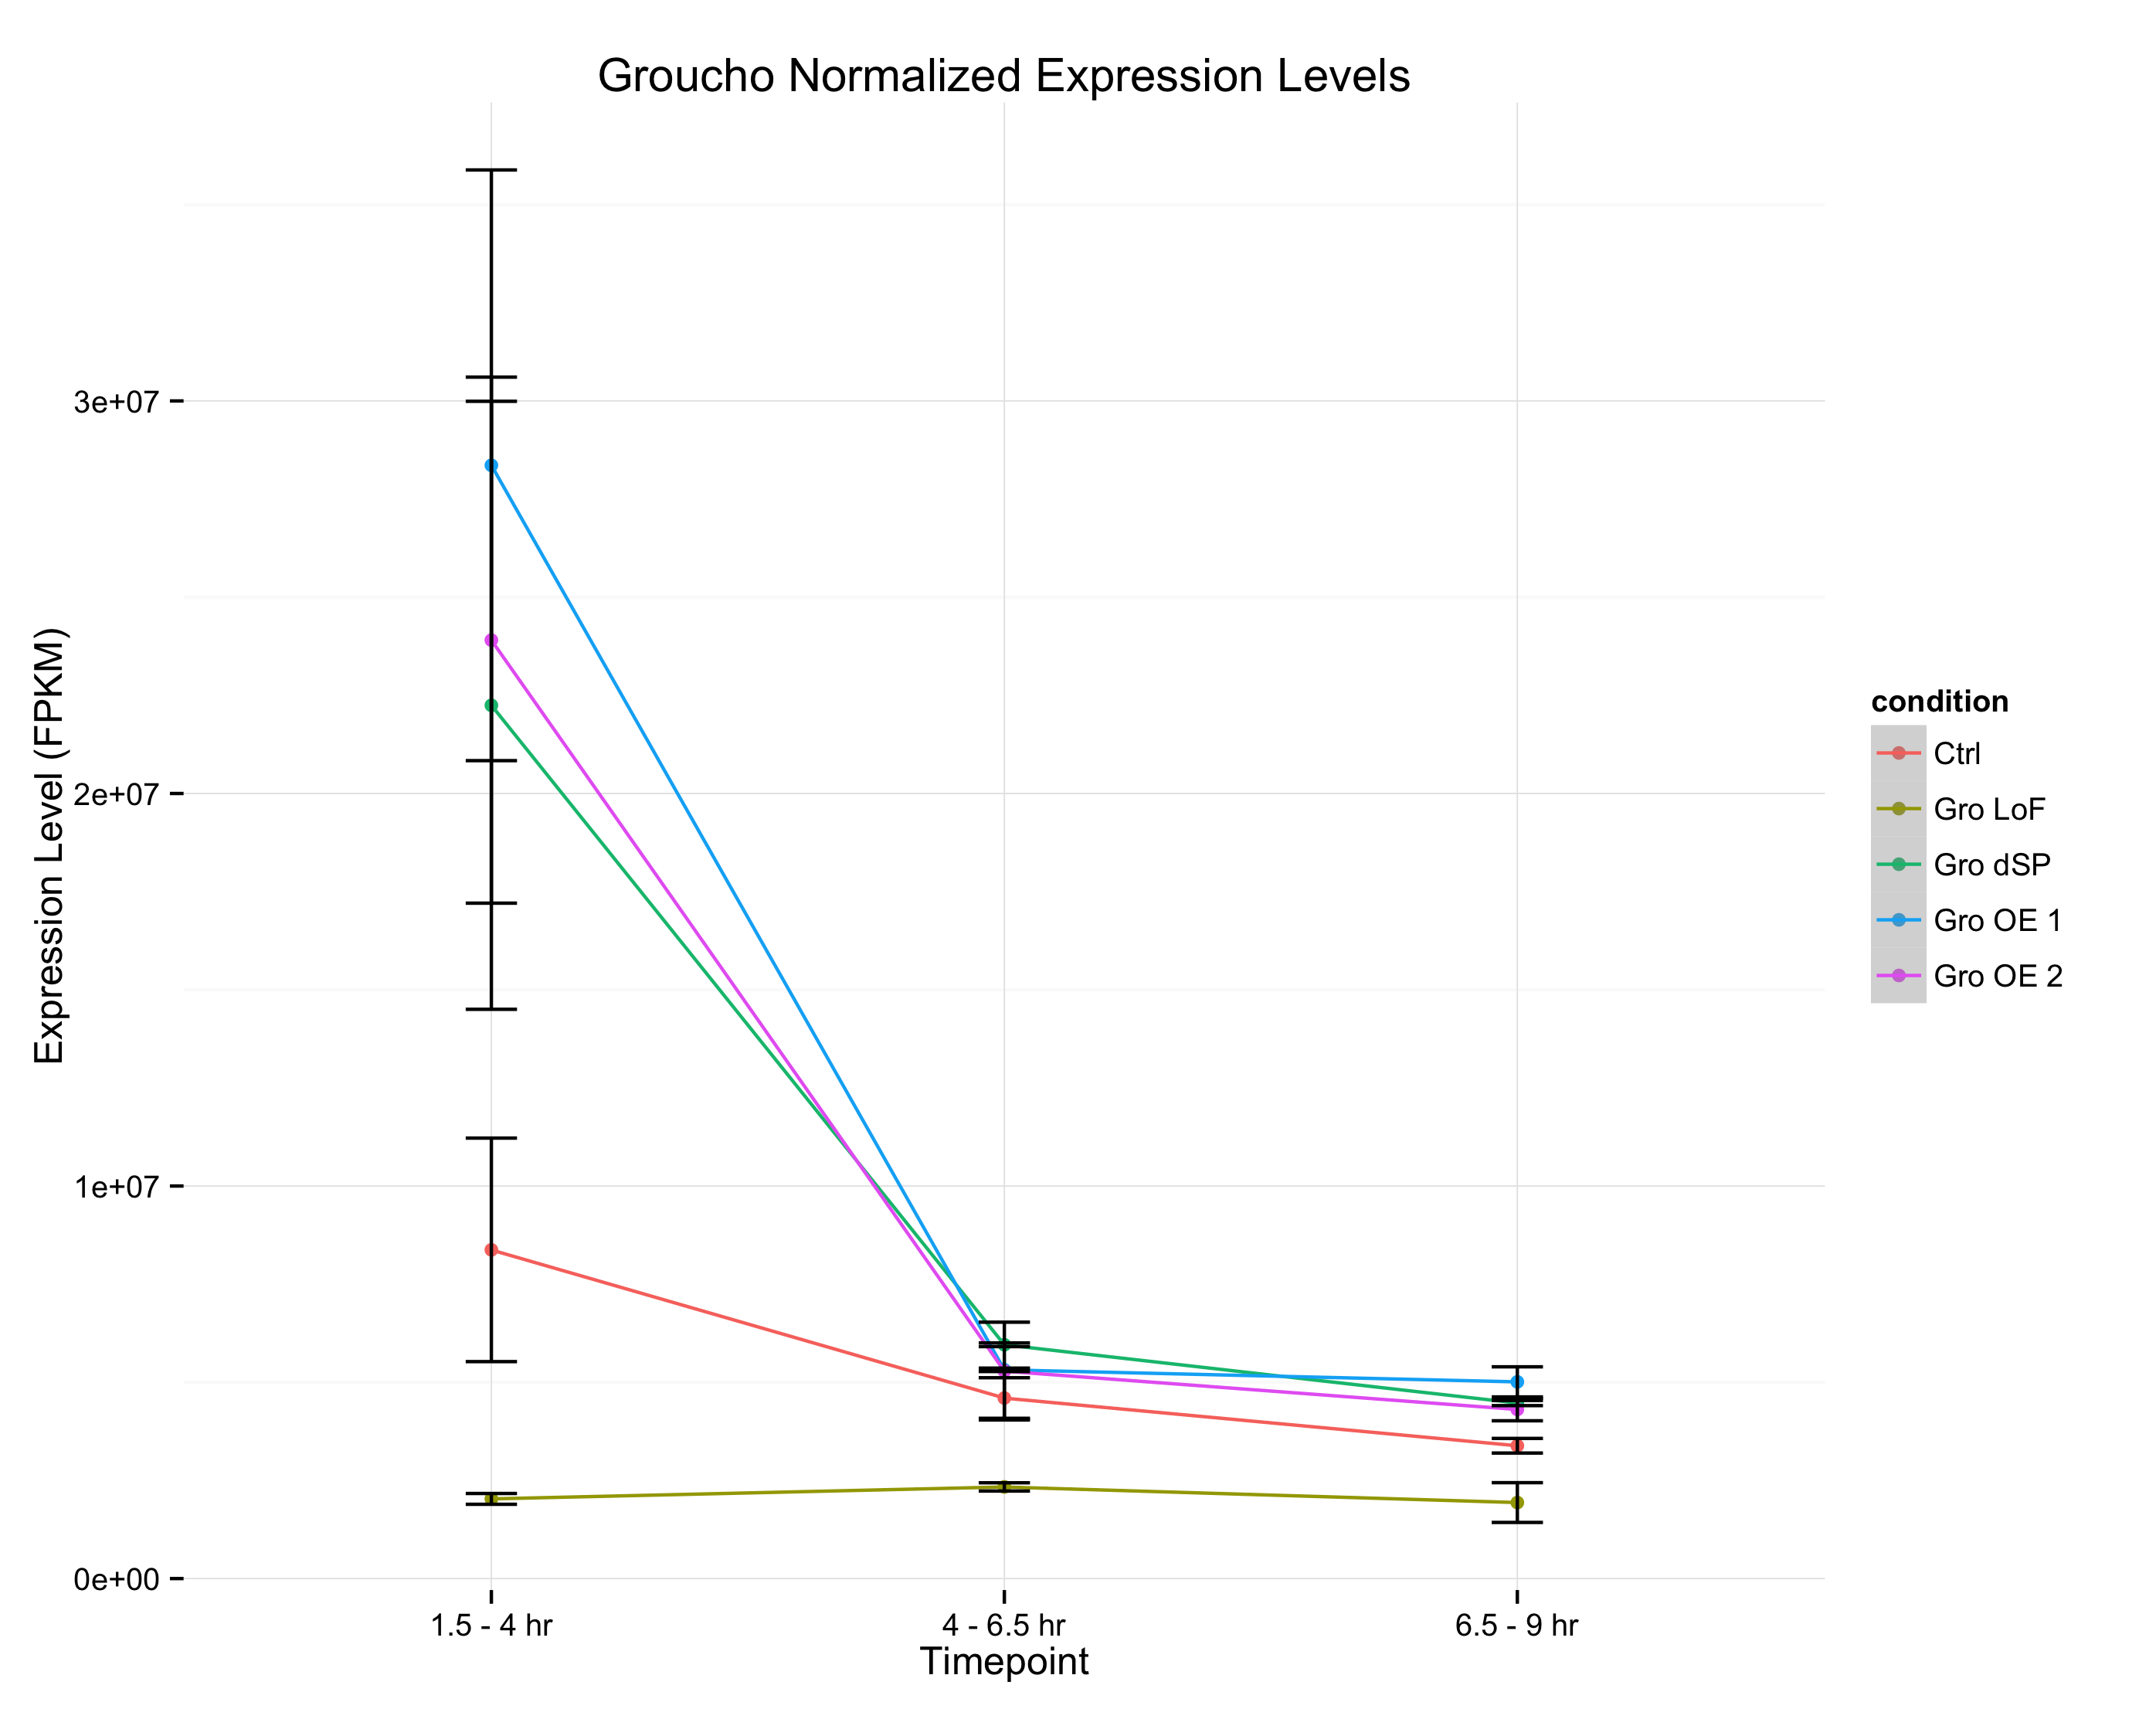
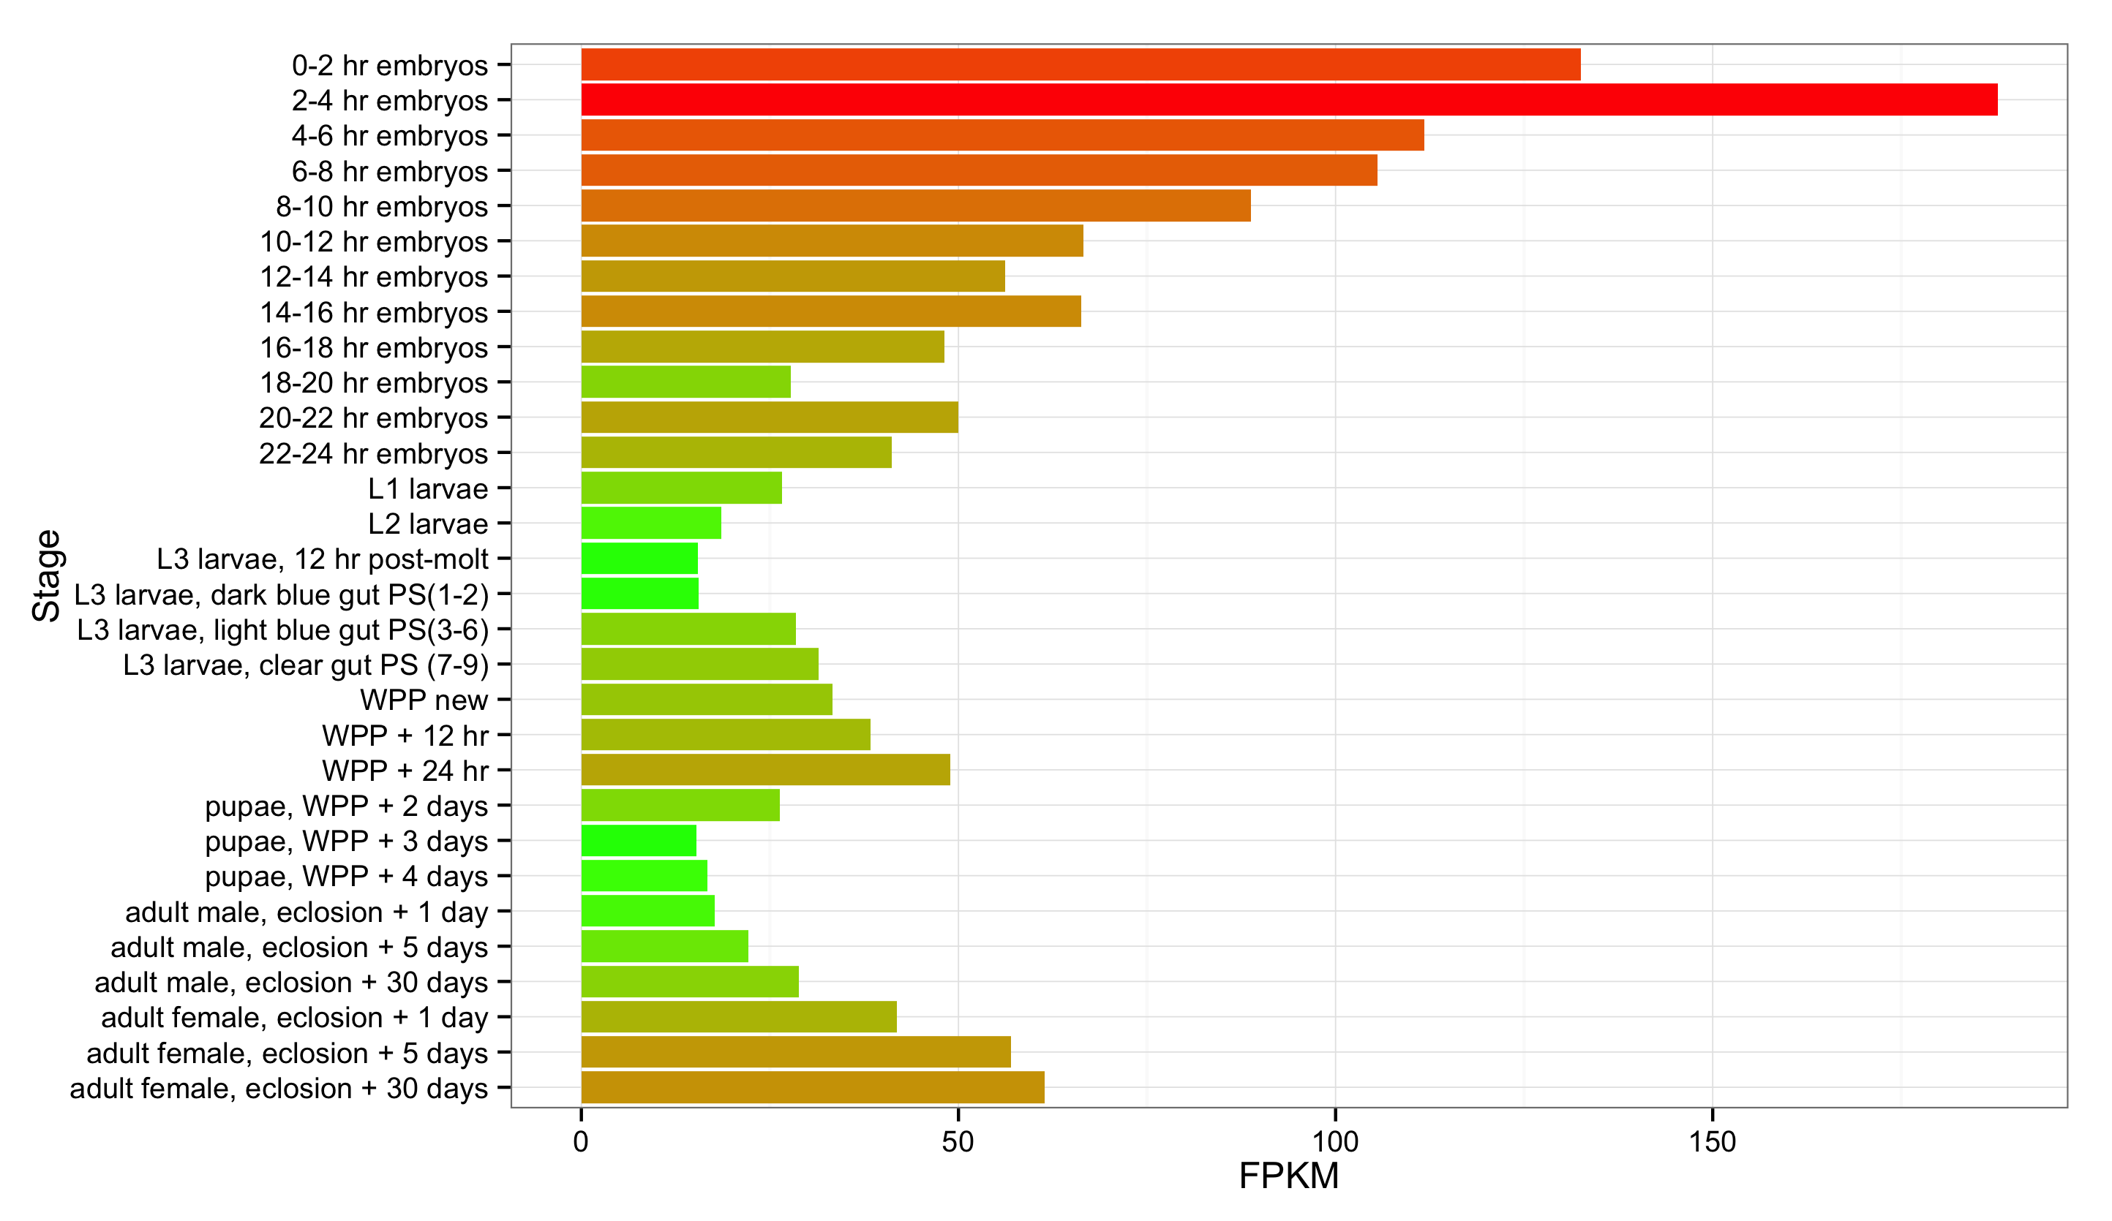
Fig. 2-m
A
Groucho transcript abundance
modENCODE Developmental Transcriptome Project
B

Slide 15
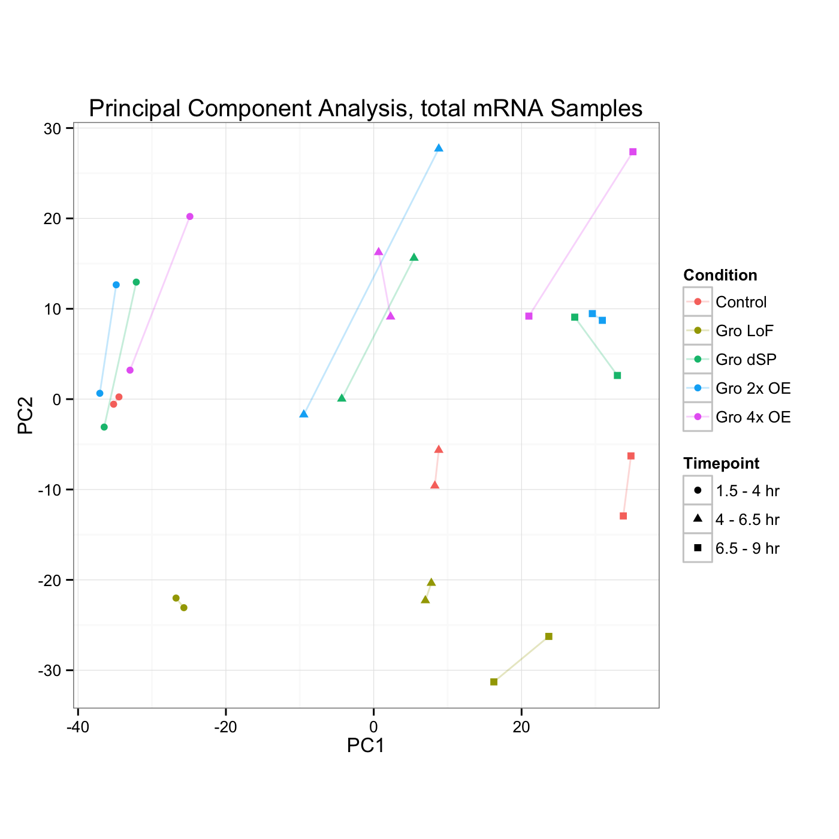
Fig. 2-n
Gro Dosage
Developmental Stage

Slide 16
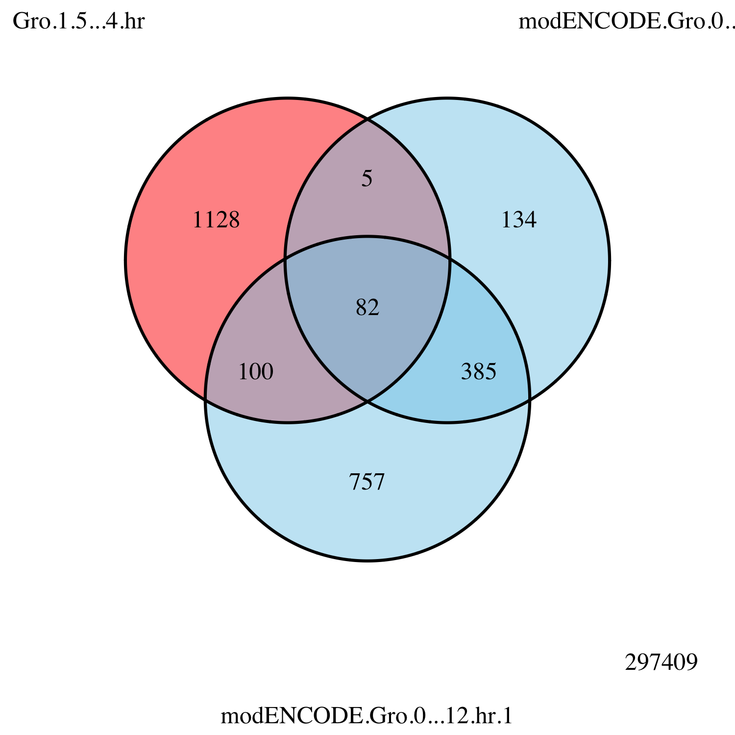
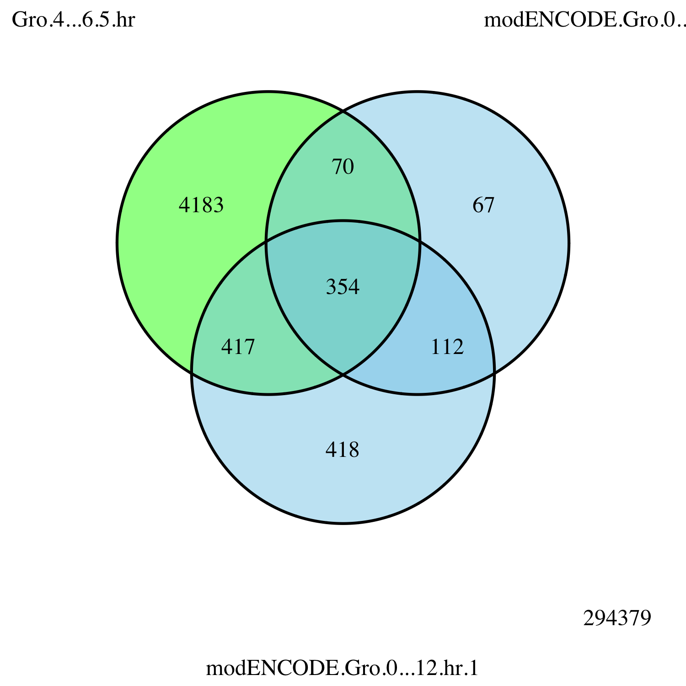
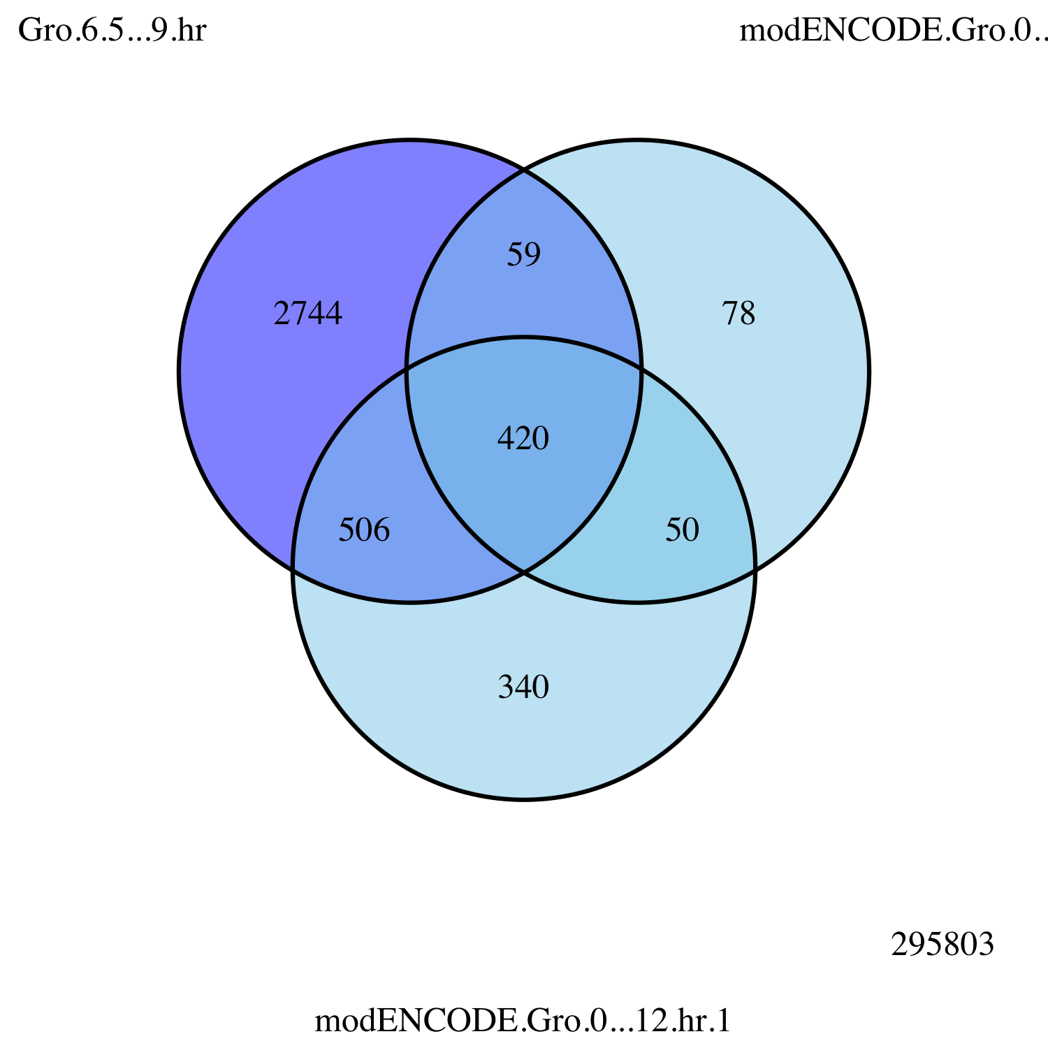
Fig. 2-o
Embryo
0 – 12 hr
Rep 2
Embryo
1.5 – 4 hr
Embryo
0 – 12 hr
Rep 1
Embryo
0 – 12 hr
Rep 2
Embryo
4 – 6.5 hr
Embryo
0 – 12 hr
Rep 1
Embryo
0 – 12 hr
Rep 2
Embryo
6.5 – 9 hr
Embryo
0 – 12 hr
Rep 1

Slide 17
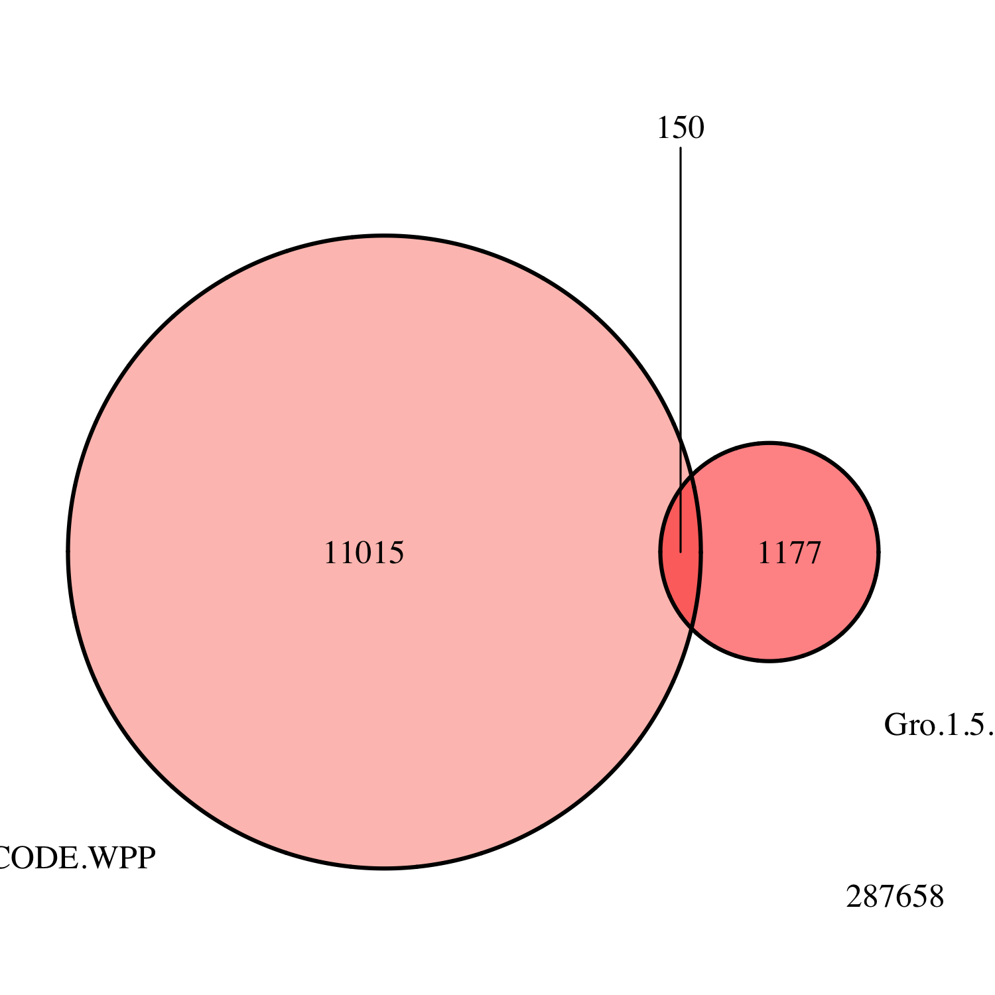
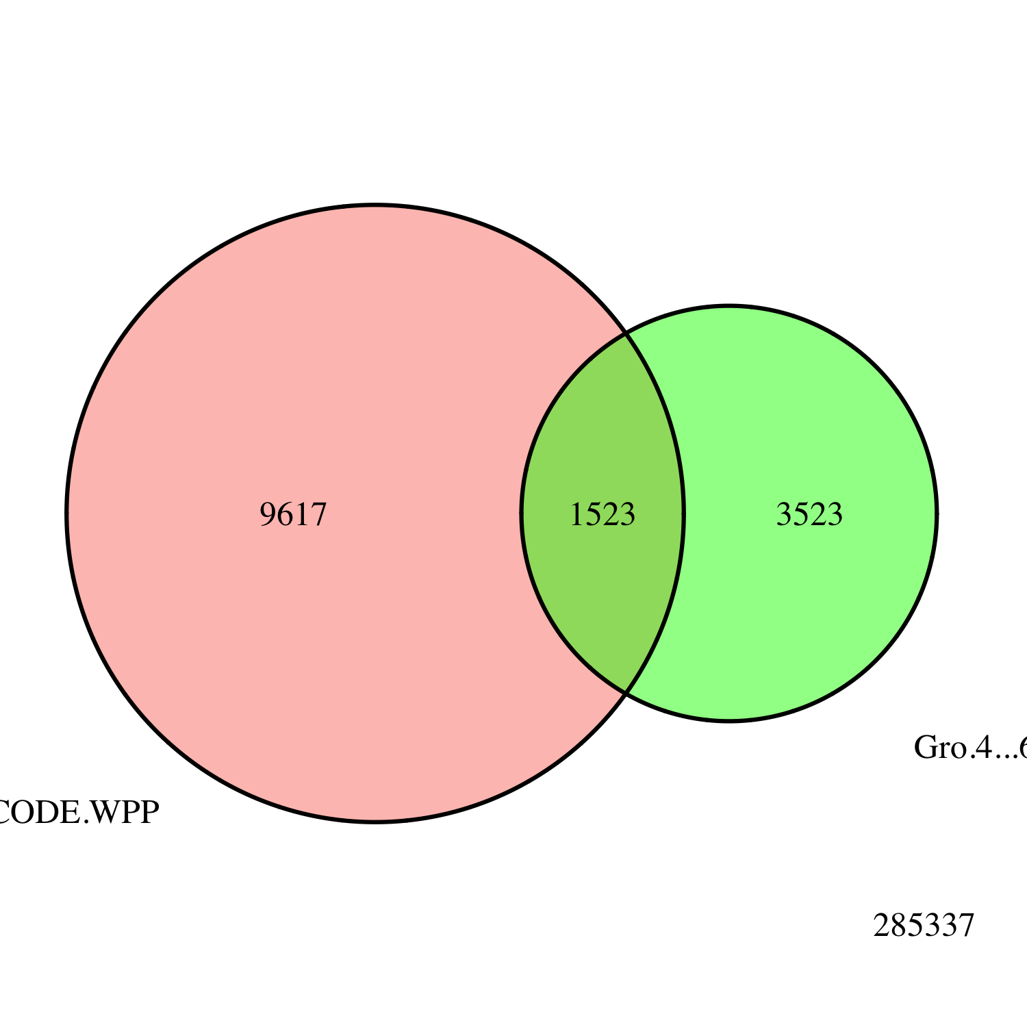
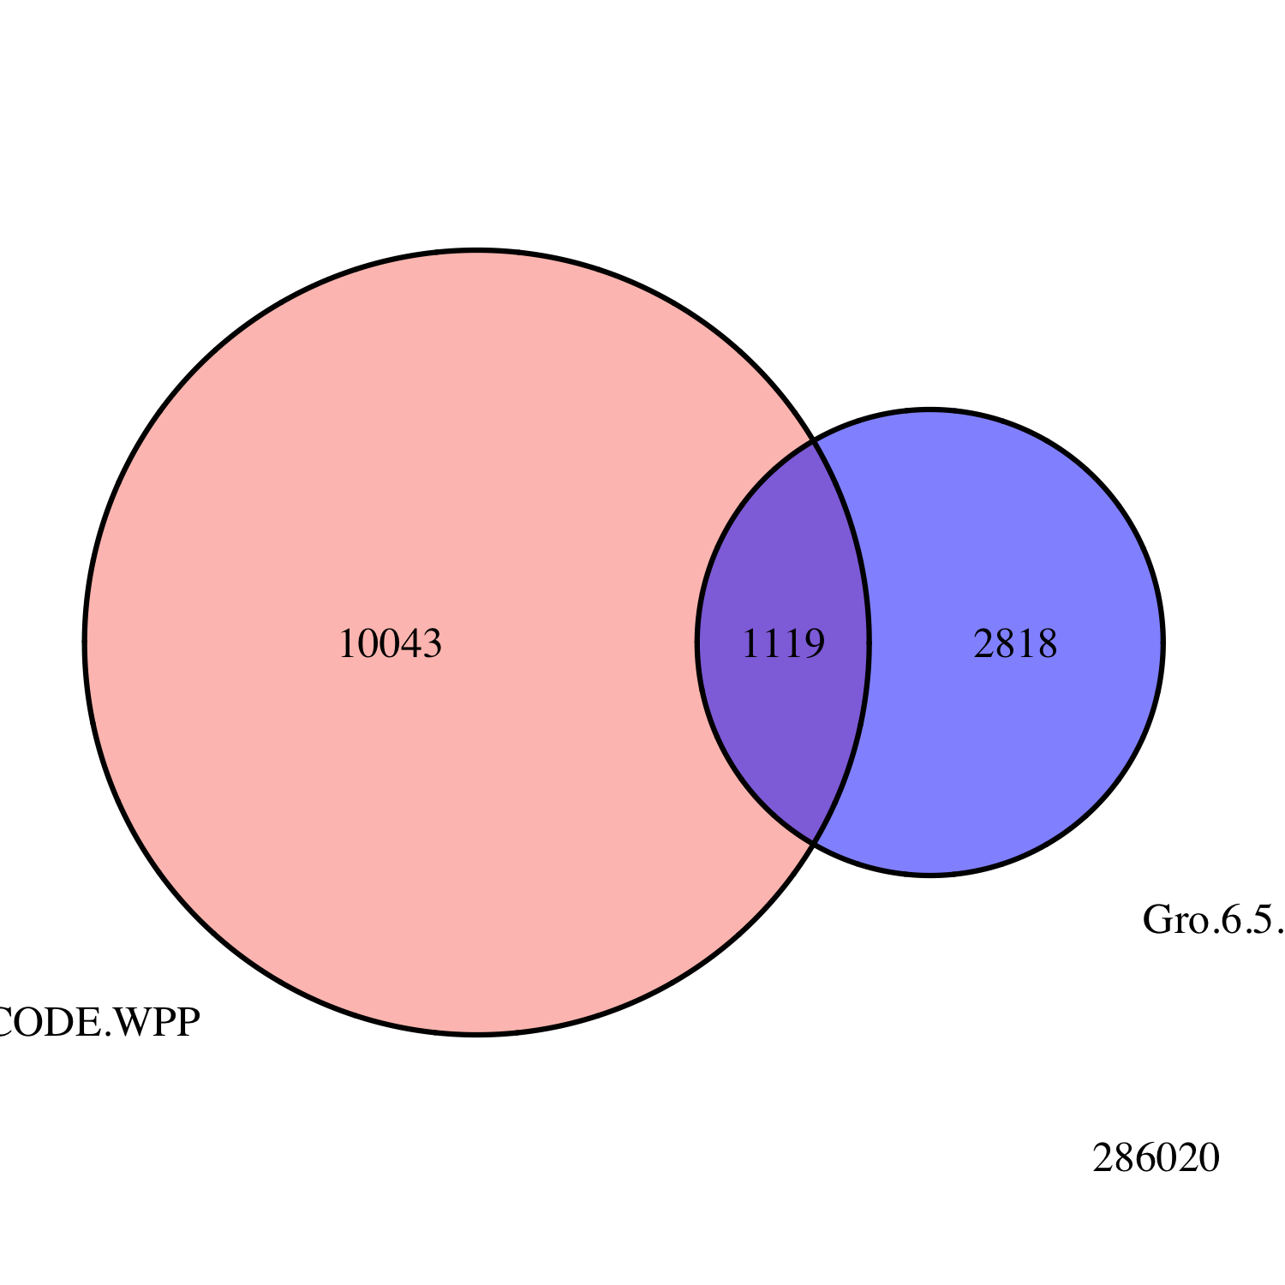
Fig. 2-p
Embryo
1.5 – 4 hr
modENCODE
White Pre-Pupae
Embryo
4 – 6.5 hr
Embryo
6.5 – 9 hr

Slide 18
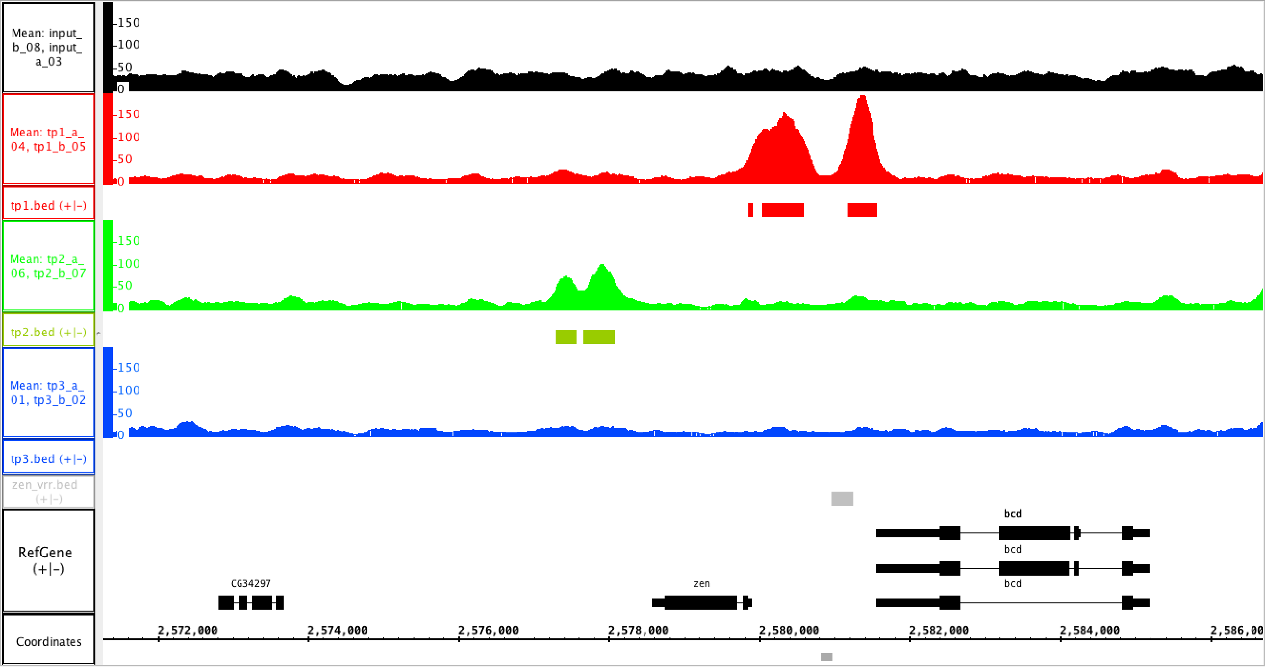
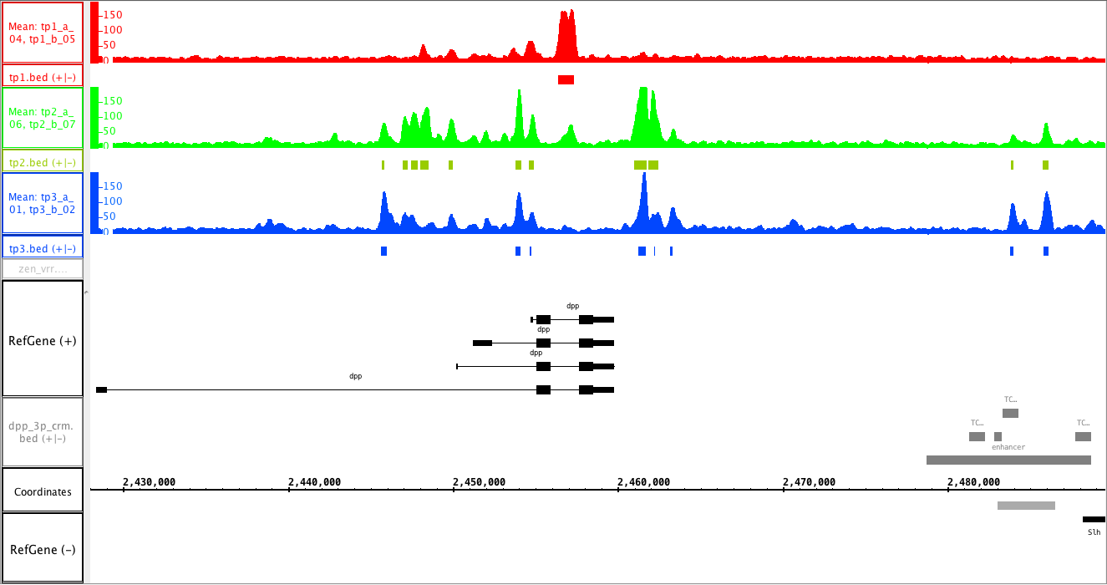
Fig. 2-q
A
1.5 – 4 hr
4 – 6.5 hr
6.5 – 9 hr
VRR
B
1.5 – 4 hr
4 – 6.5 hr
6.5 – 9 hr

Slide 19
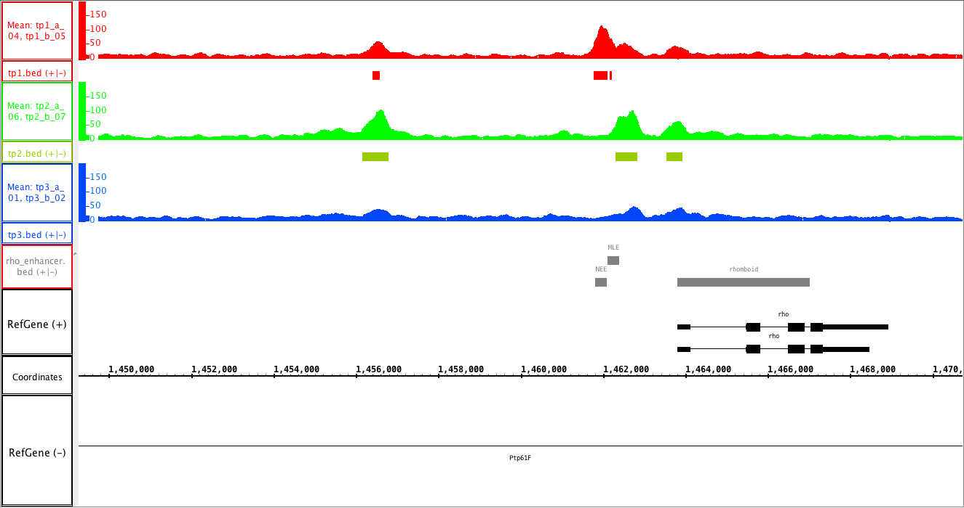
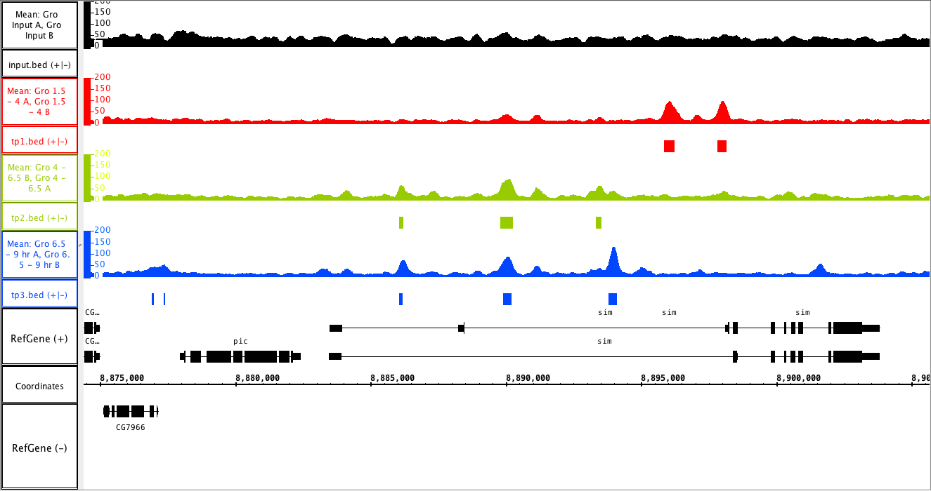
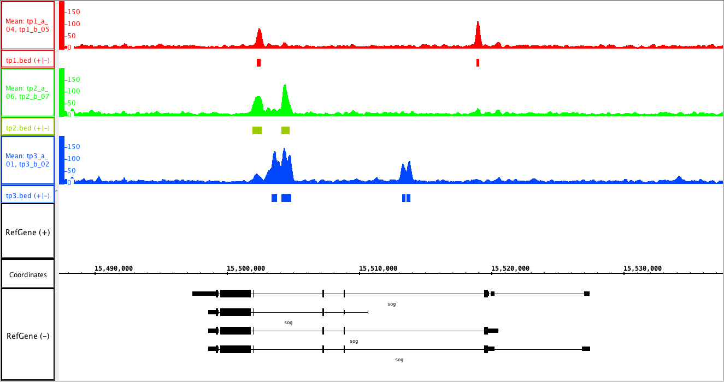
Fig. 2-r
A
1.5 – 4 hr
4 – 6.5 hr
6.5 – 9 hr
B
1.5 – 4 hr
4 – 6.5 hr
6.5 – 9 hr
C
1.5 – 4 hr
4 – 6.5 hr
6.5 – 9 hr

Slide 20
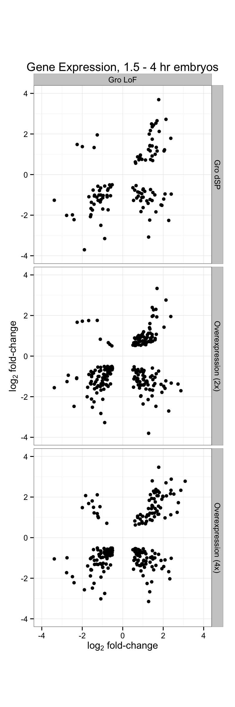
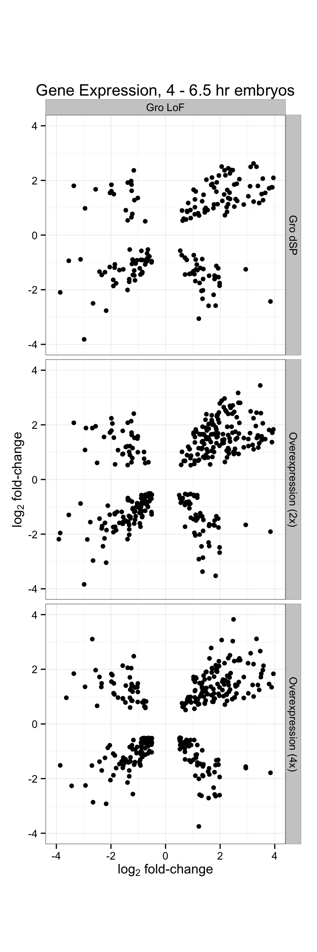
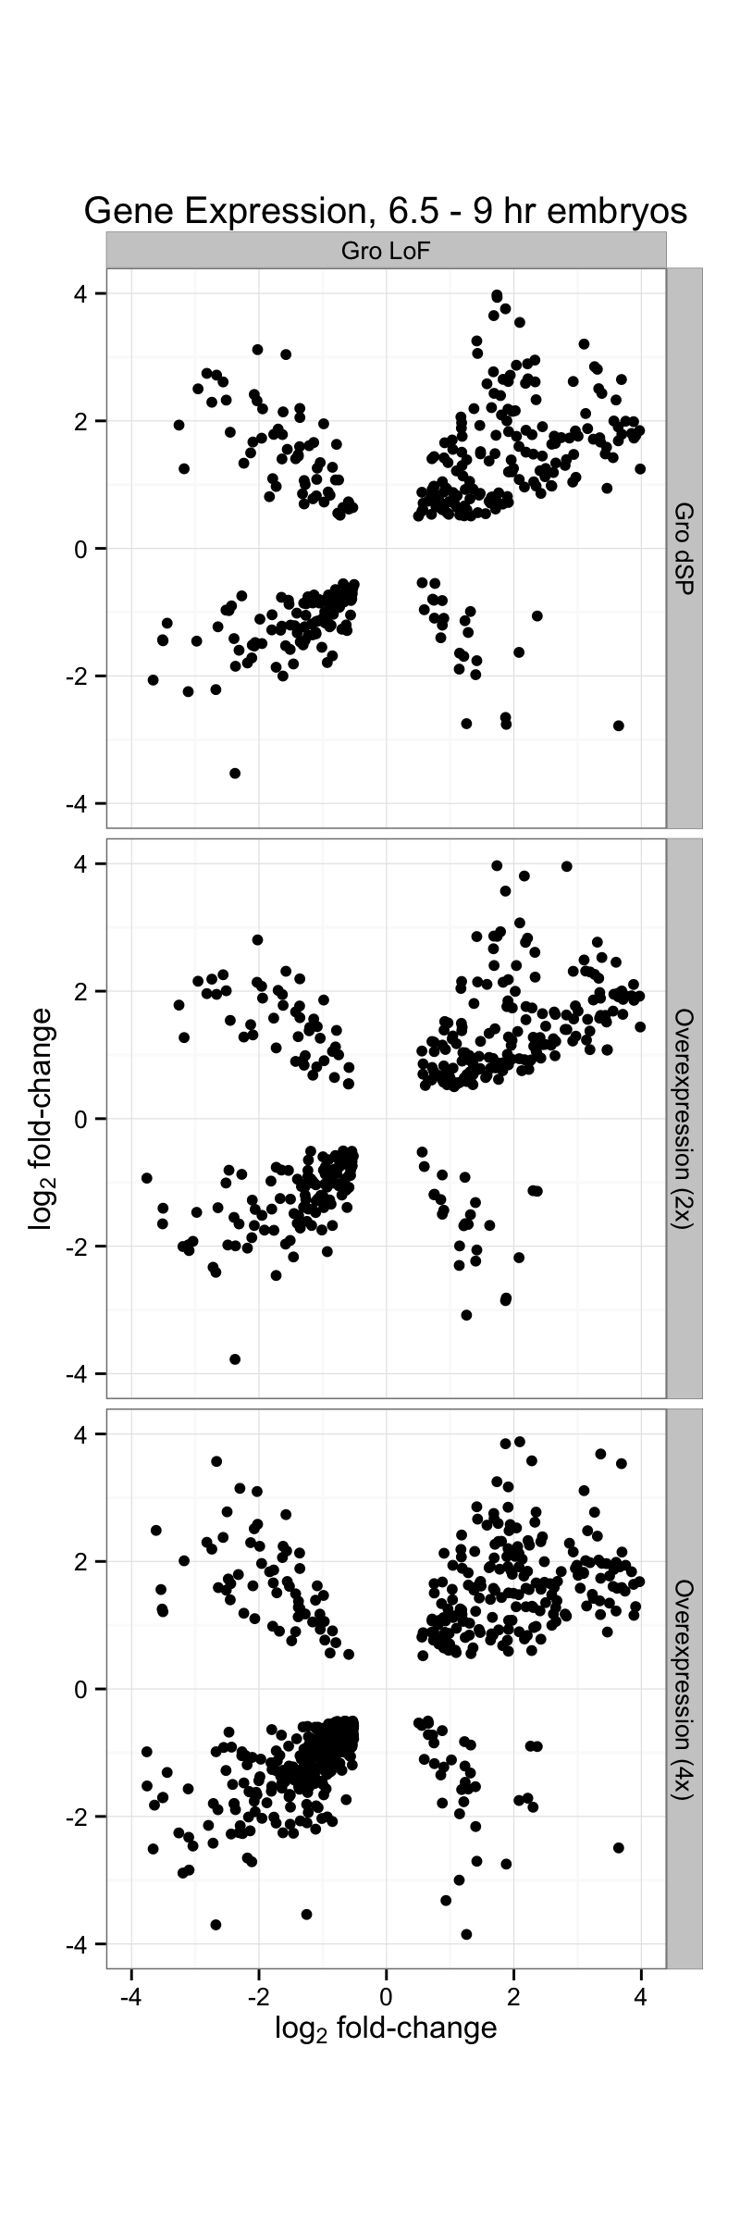
Fig. 2-s

Slide 21
Fig. 2-t
Gro loss-of-function
vs.
2x Gro Overexpression
Gro loss-of-function
vs.
4x Gro Overexpression

Slide 22
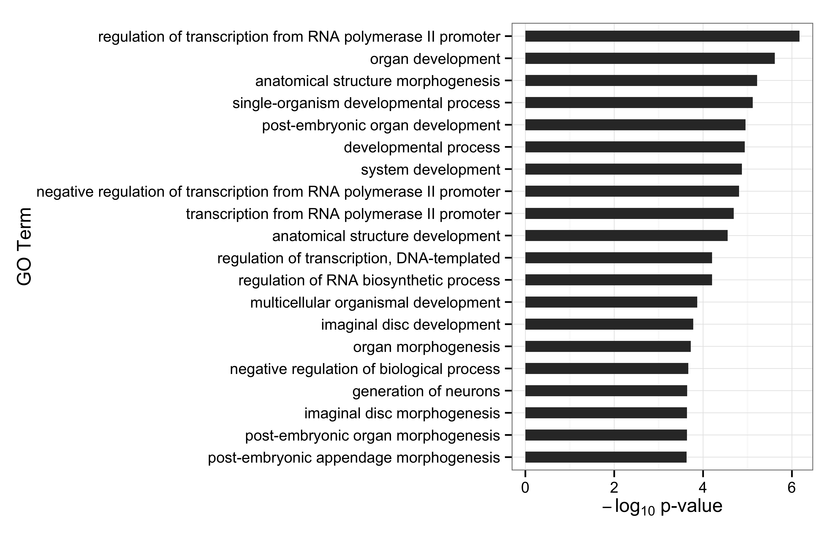
Fig. 2-u

Slide 23
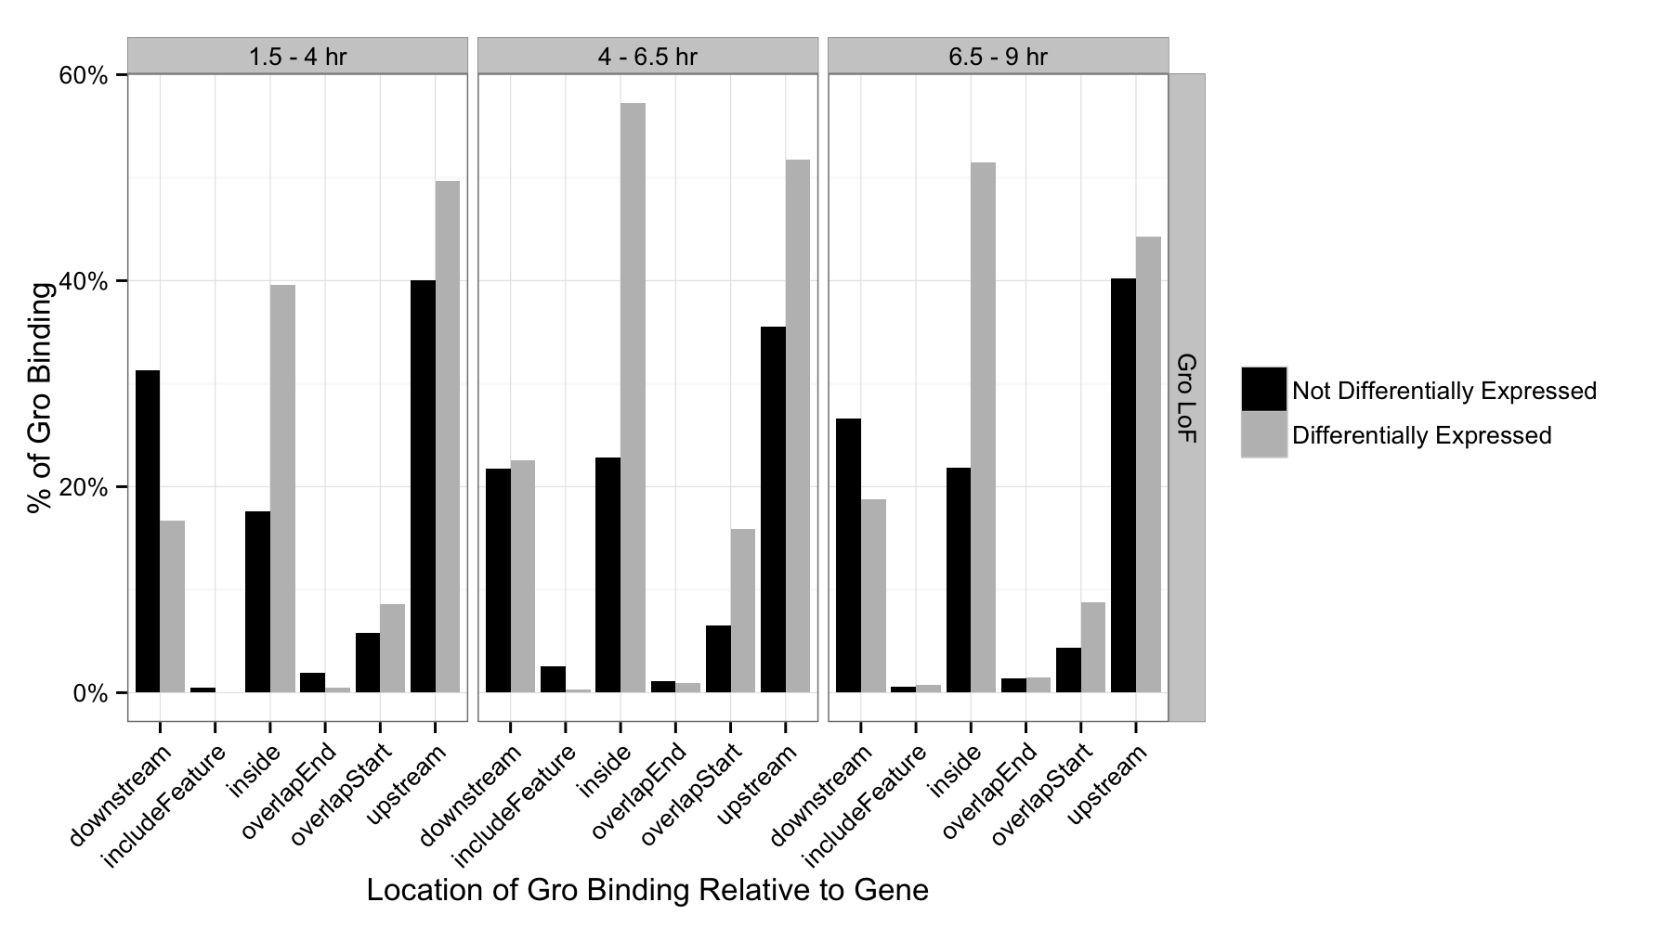
Fig. 2-v

Slide 24
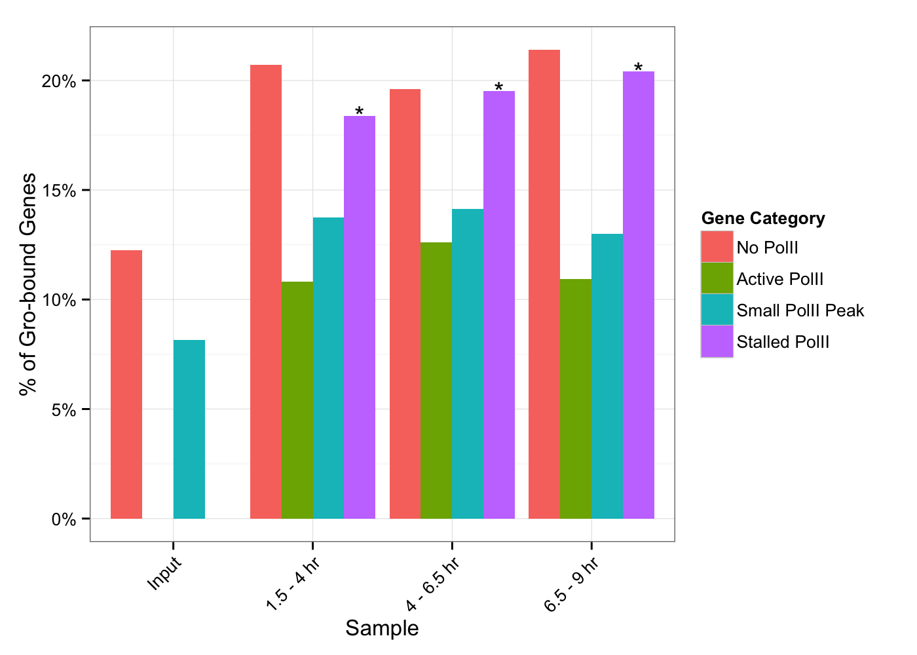
Fig. 2-w

Slide 25
Fig. 2-x

